Slide 1
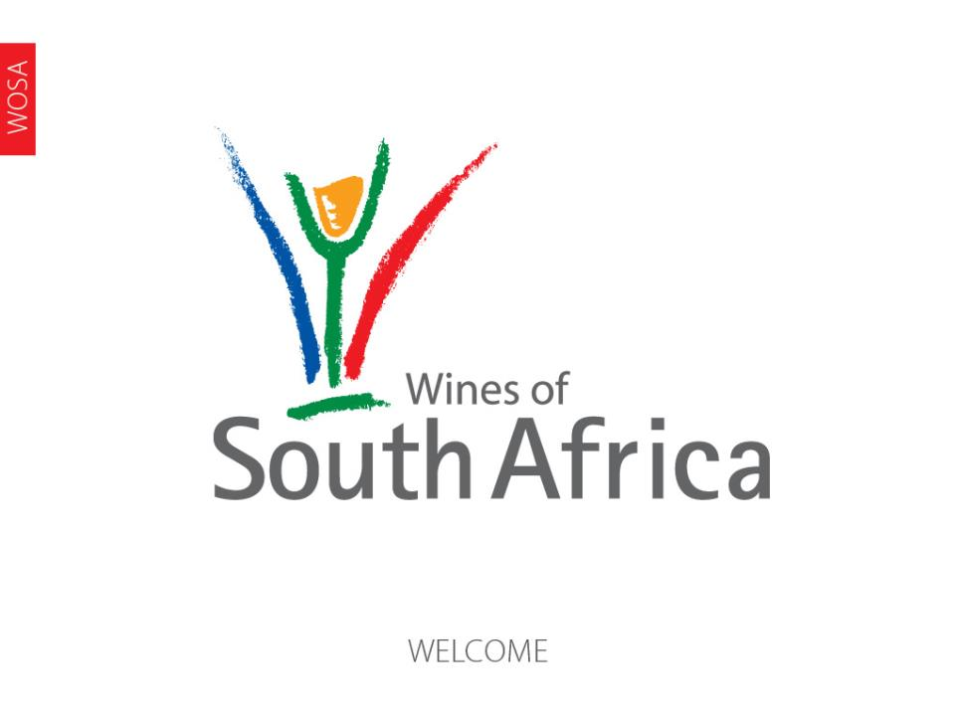
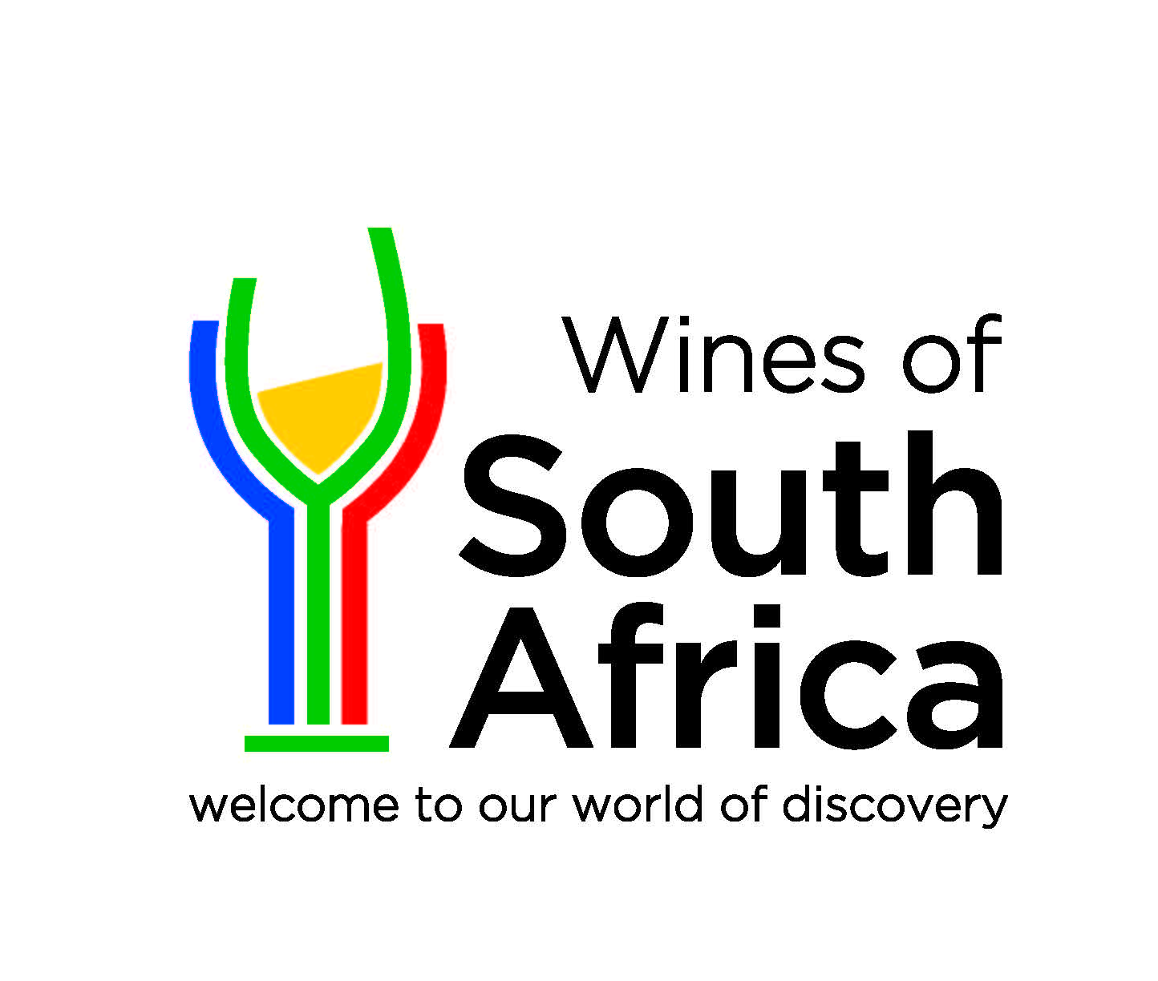
Notes:
Wines of South Africa

Slide 2
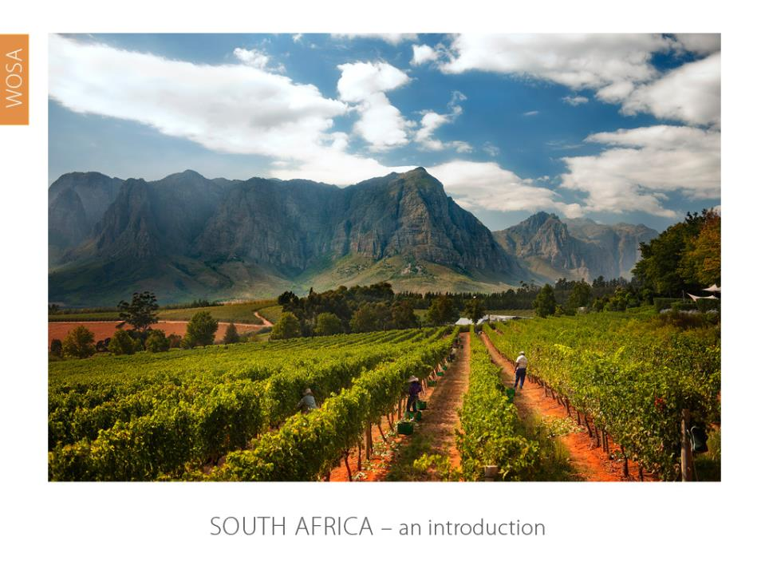
Notes:
An introduction

Slide 3
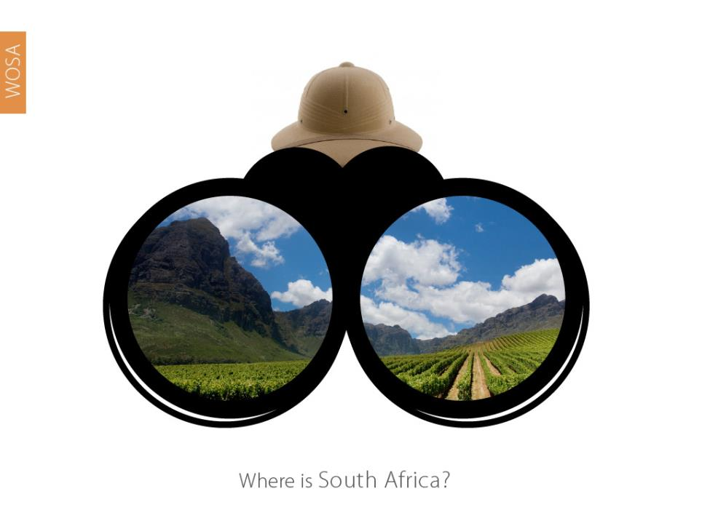
Notes:
Where is South Africa?

Slide 4
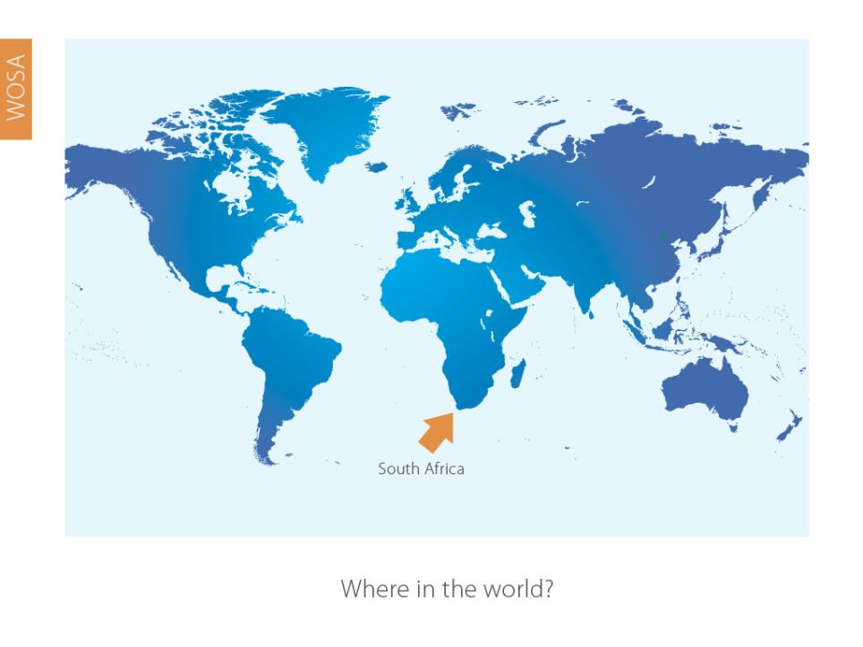
Notes:
South Africa is the southernmost country in Africa and our winelands are located at the very tip of South Africa.

Slide 5
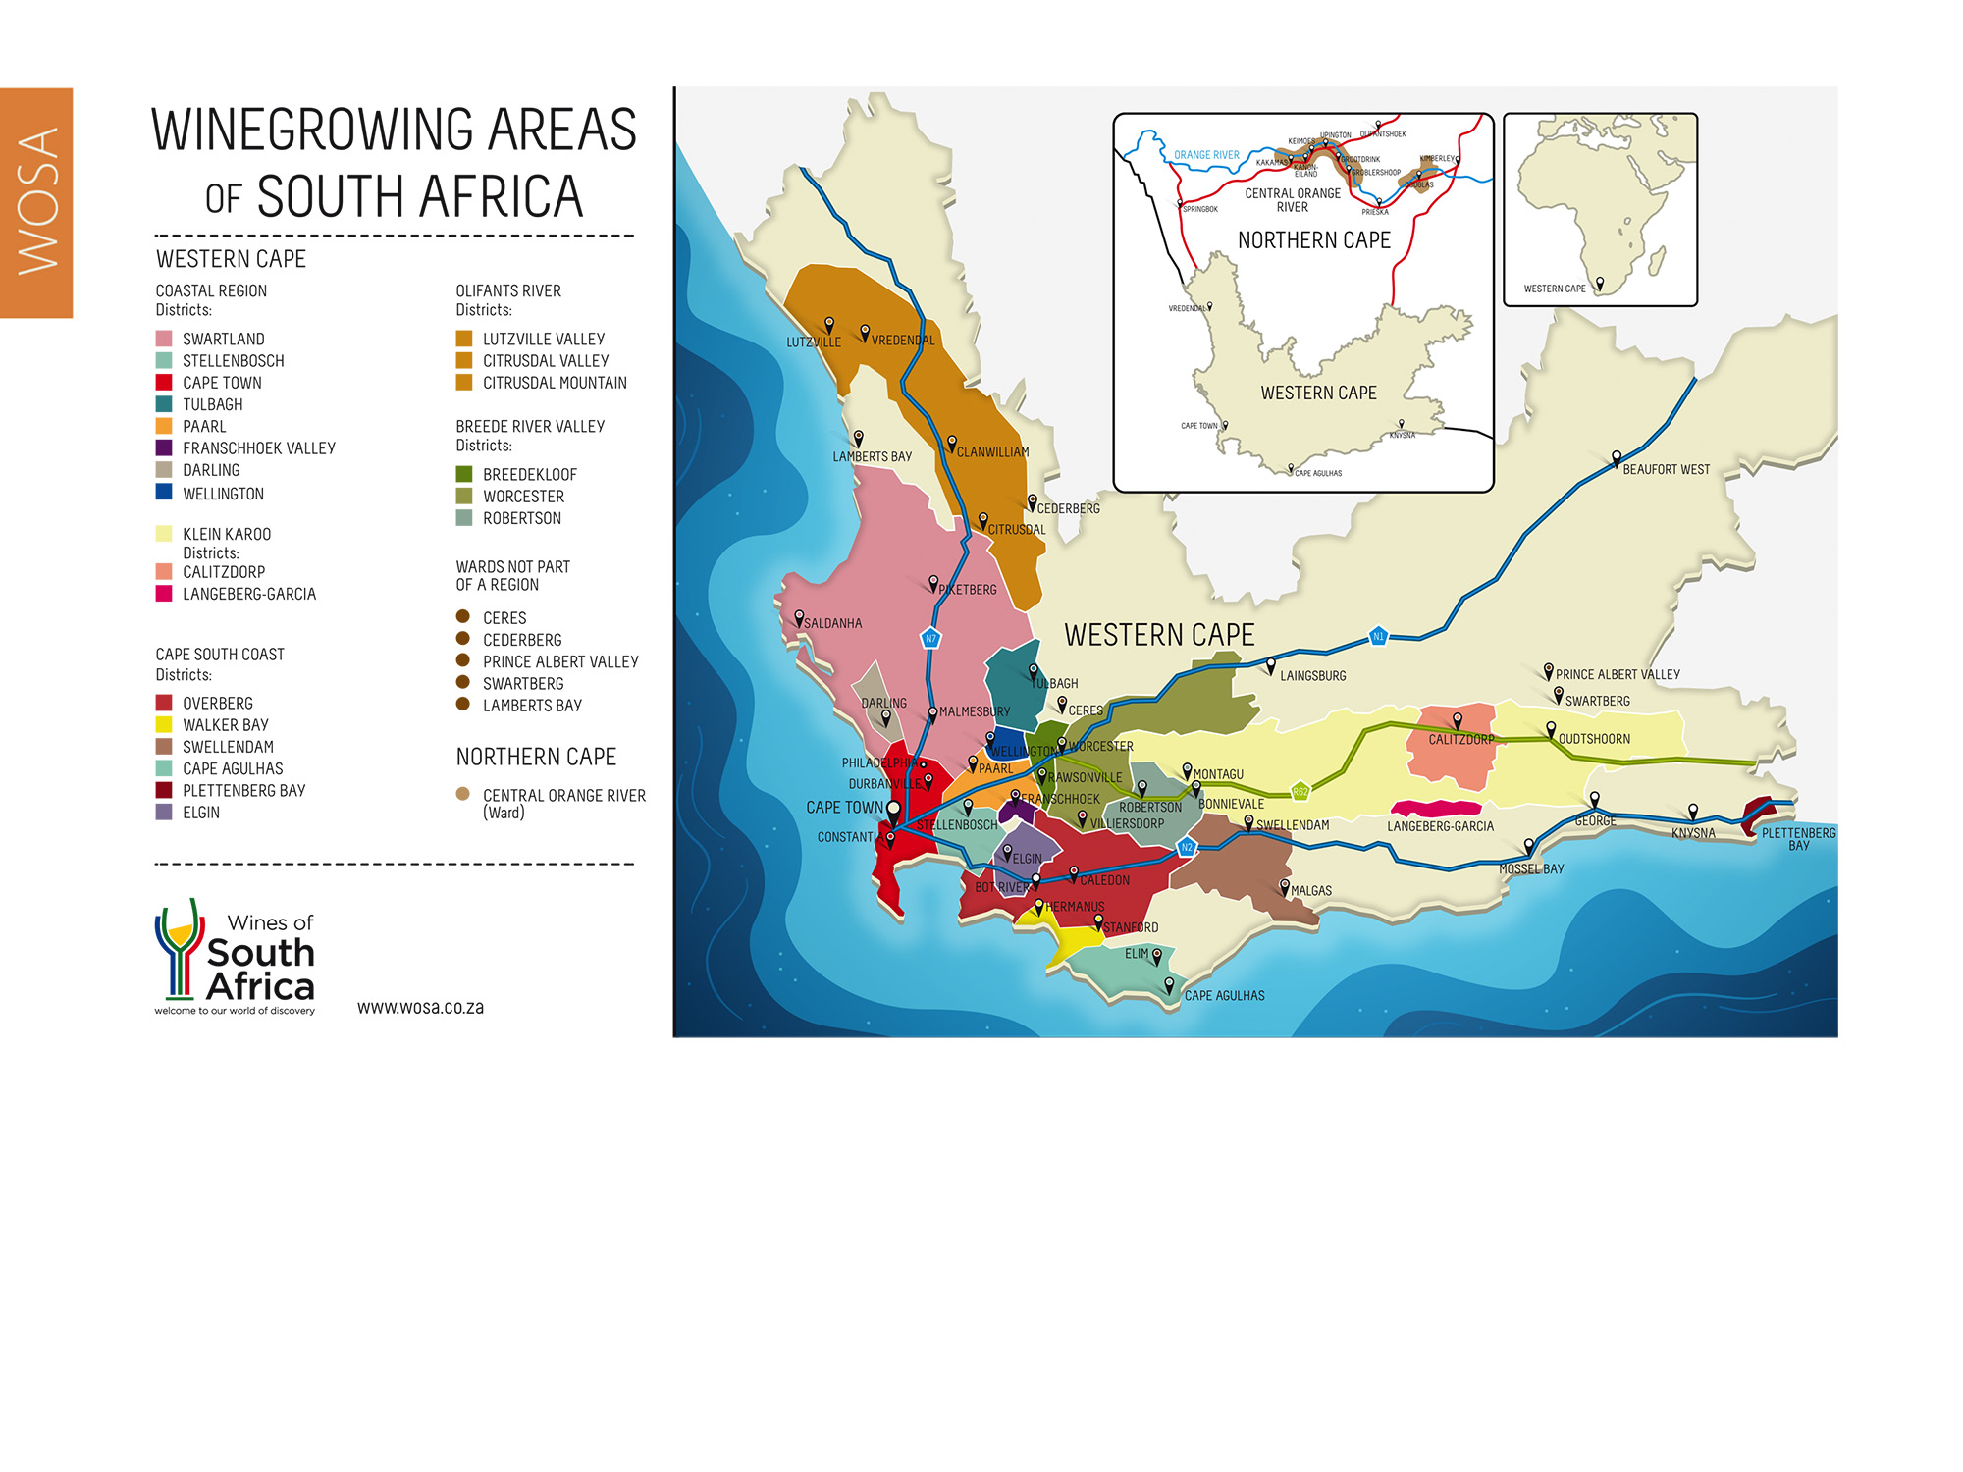
Notes:
Cape Town is the gateway to our winelands with several diverse regions within close proximity.

Slide 6
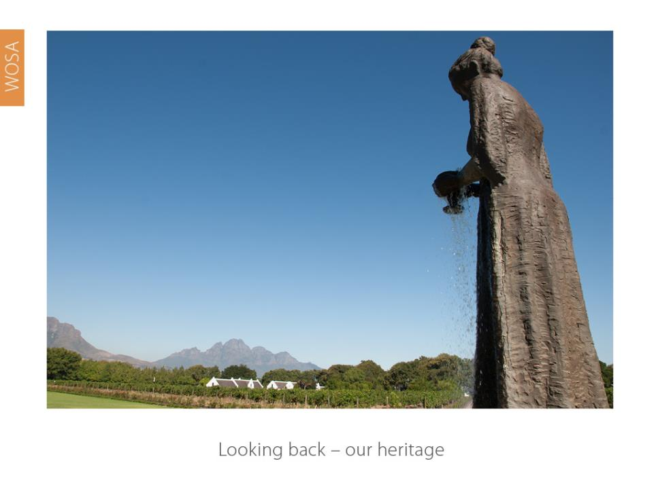
Notes:
Looking back…

Slide 7
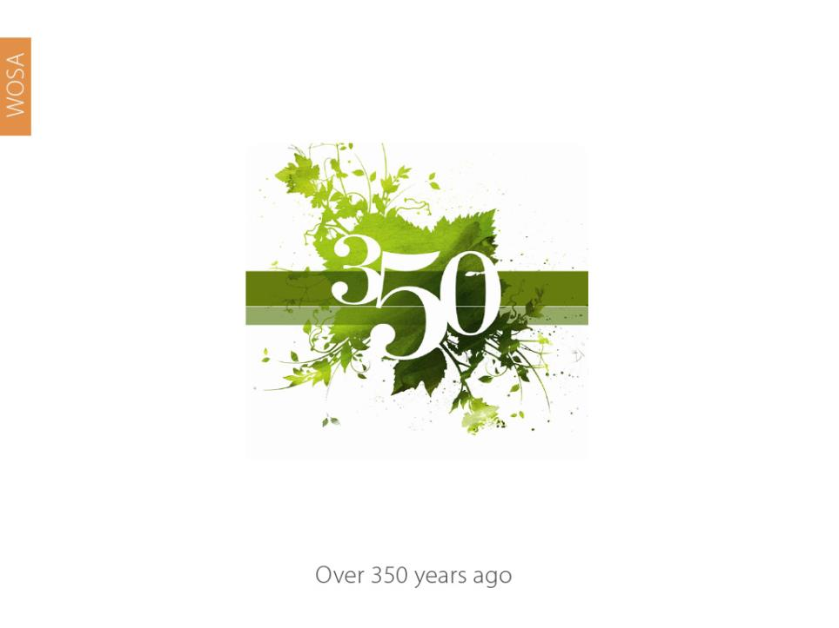
Notes:
South Africa has celebrated 350 years of winemaking.

Slide 8
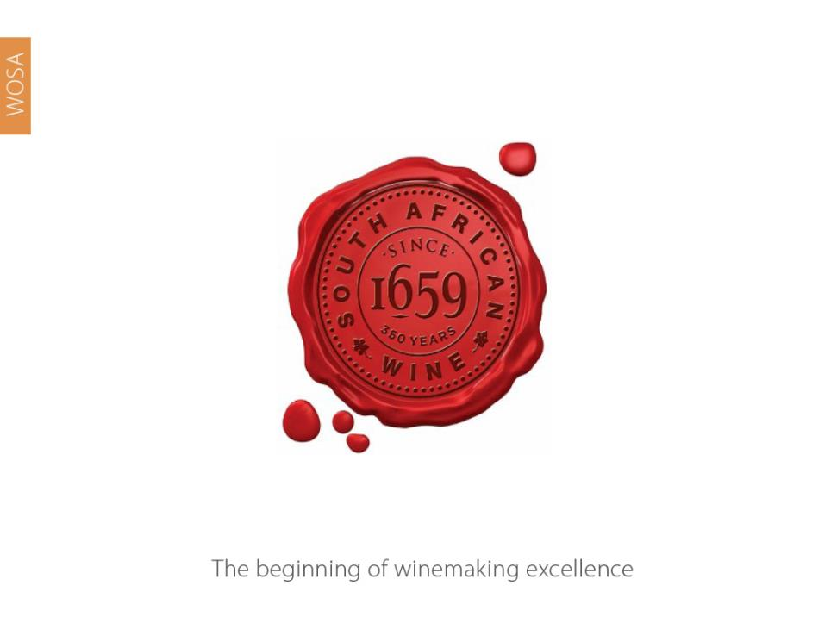
Notes:
Winemaking dates back to 1659.

Slide 9
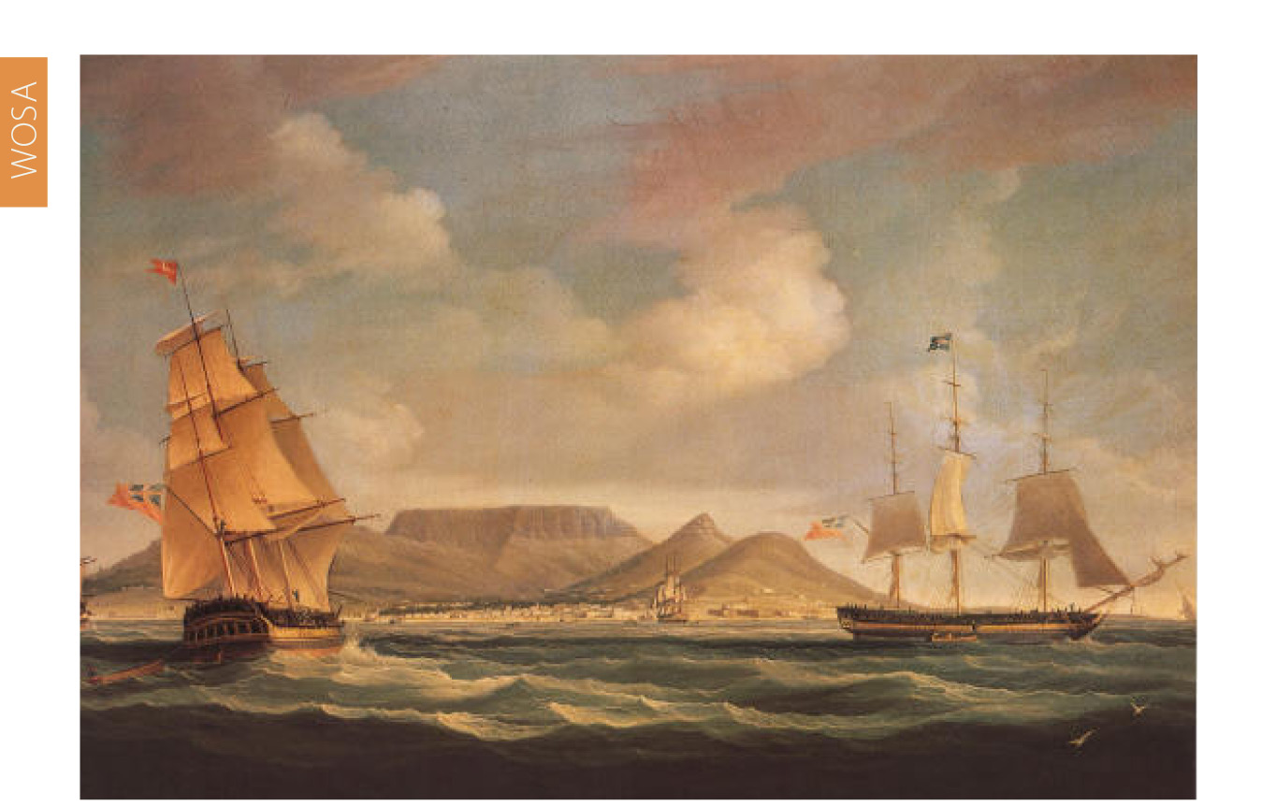
1652 – The Dutch East India Company established a refreshment station
to provide for the ships en route to the spice trade in the East
Notes:
1652 – The Dutch East India Company established a refreshment station to provide for the ships en route to the spice trade in the East.

Slide 10
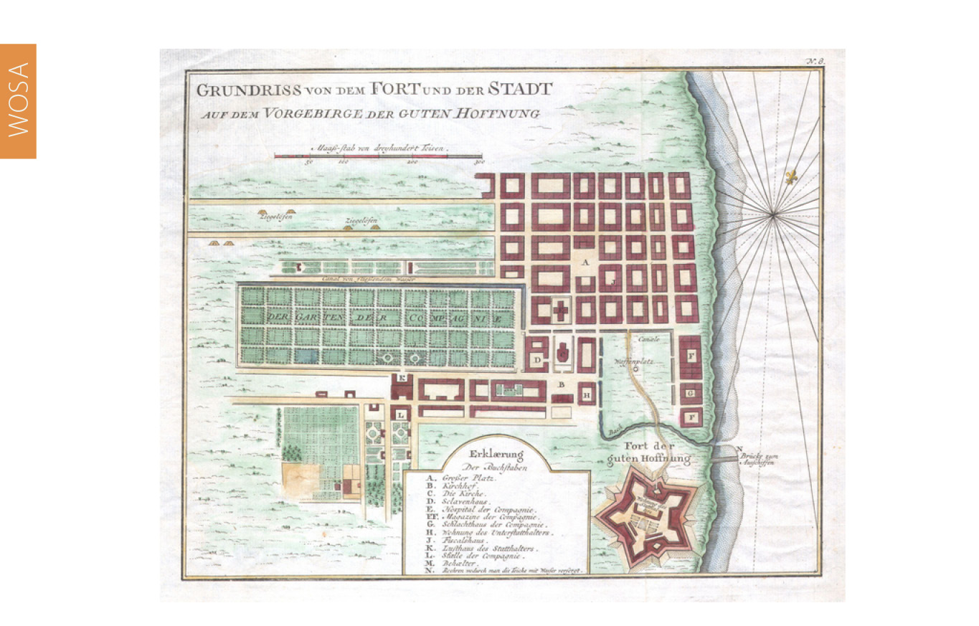
1655 – Governor Jan van Riebeeck planted the first vines, imported from
France, Spain and the Rhineland, in the Company Gardens
Notes:
1655 – Governor Jan van Riebeeck planted the first vines, imported from France, Spain and the Rhineland, in the Company Gardens.

Slide 11
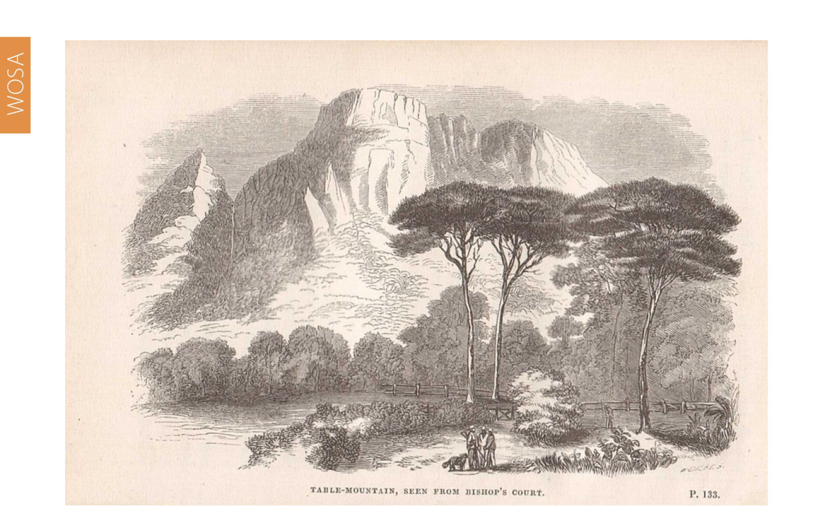
1658 – Van Riebeeck planted 1 000 vines on his farm, Boscheuvel,
in what is today Bishops Court and Wynberg
Notes:
1658 – Van Riebeeck planted 1 000 vines on his farm, Boscheuvel, in what is today Bishops Court and Wynberg.

Slide 12
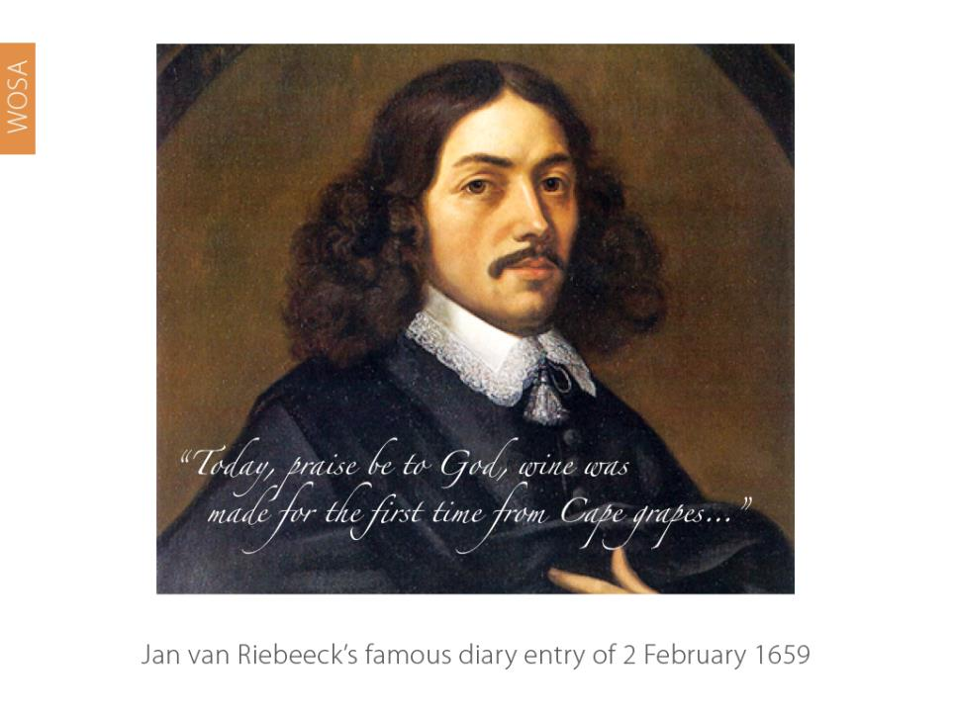
Notes:
1659 – “Today , praise be to God, wine was made for the first time from Cape grapes...” Jan van Riebeeck’s famous diary entry on 2 February of that year. Out of all of the world’s wine-producing nations, South Africa is unique in knowing the exact date on which the wine industry began, thanks to this entry.

Slide 13
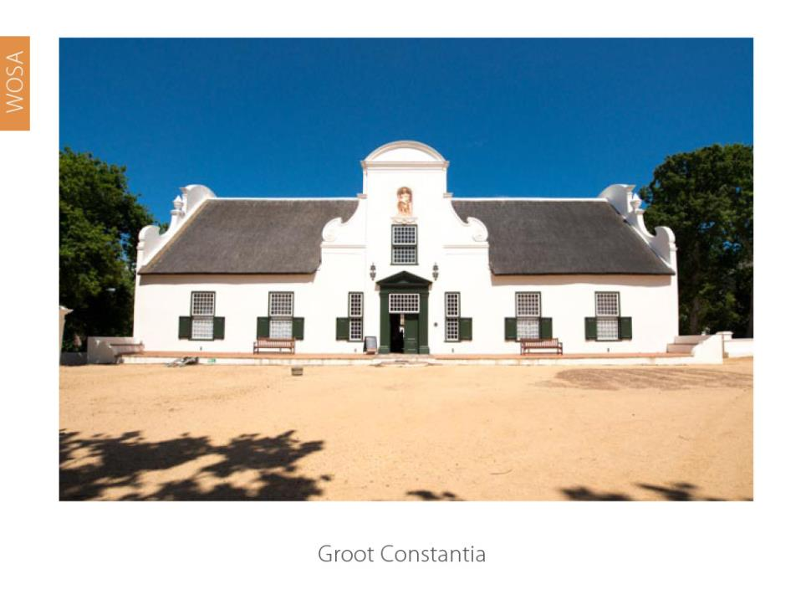
Notes:
Governor Simon van der Stel planted some 10 000 vines on the slopes of the Constantiaberg in 1685.
Today, centuries-old Cape Dutch homesteads are beautifully preserved on many of the Cape’s famous wine estates. Some good examples are:

Slide 14
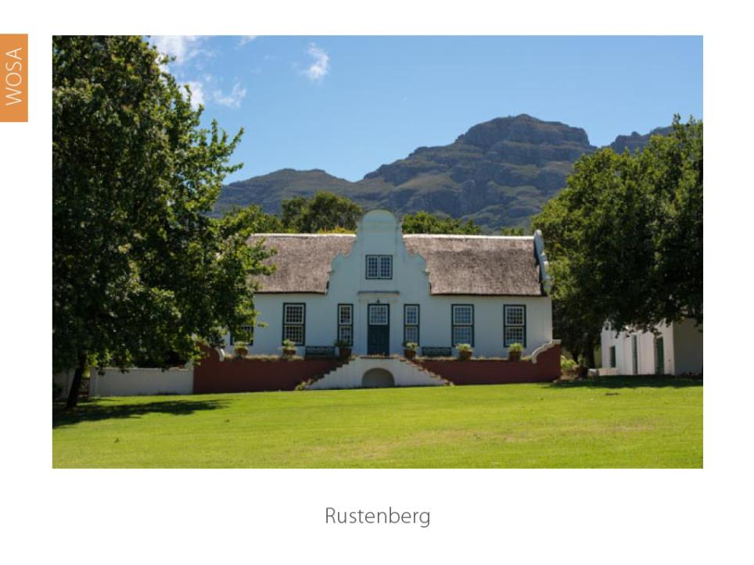
Notes:
Rustenberg

Slide 15
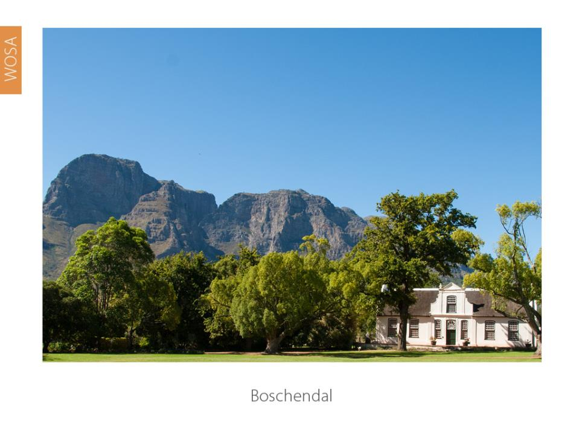
Notes:
Boschendal

Slide 16
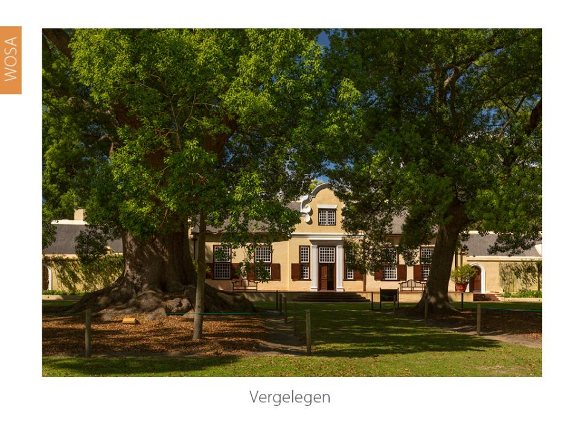
Notes:
Vergelegen, with camphor trees that are more than 300 years old.

Slide 17
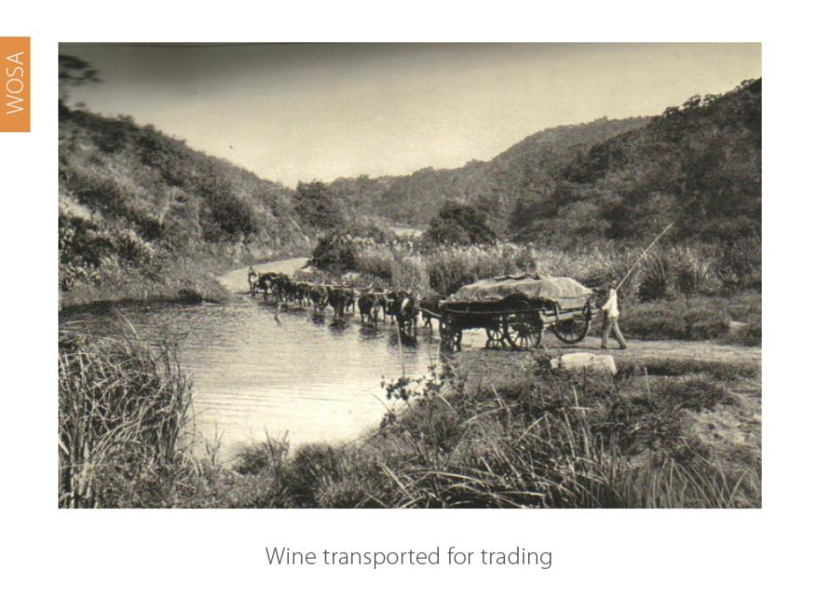
Notes:
As trade grew, winegrowing spread into the countryside. Wine was transported from outlying areas by ox wagon.

Slide 18
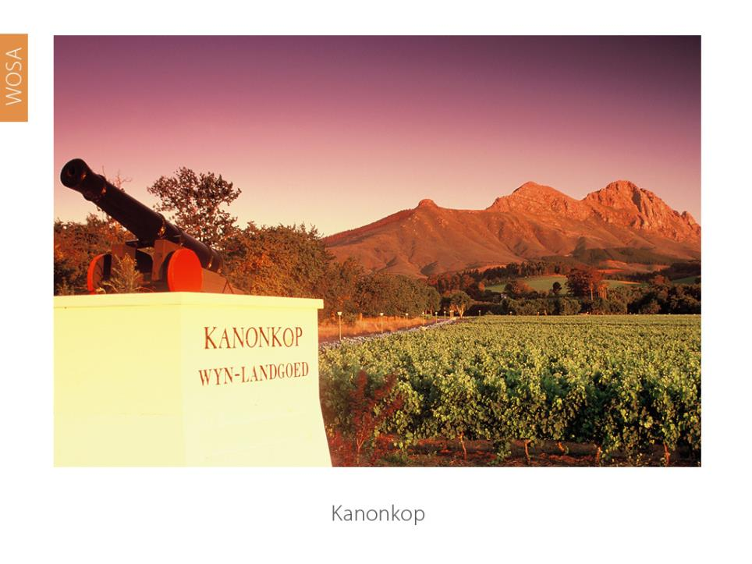
Notes:
Canons were fired on the hilltops to alert farmers to the arrival of ships in Table Bay. Kanonkop, the name of a famous Stellenbosch wine estate, means Cannon Hill.

Slide 19
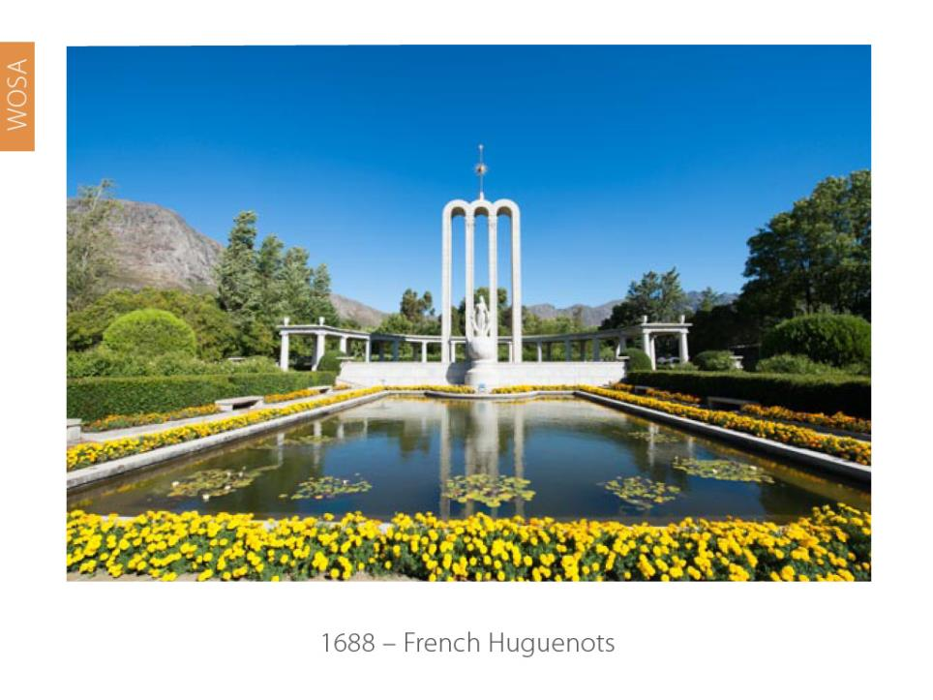
Notes:
1688 – Fleeing religious persecution in France, a group of 150 Huguenots arrived, settling in the Drakenstein Valley, which subsequently became known as Fransche Hoek (later Franschhoek).

Slide 20
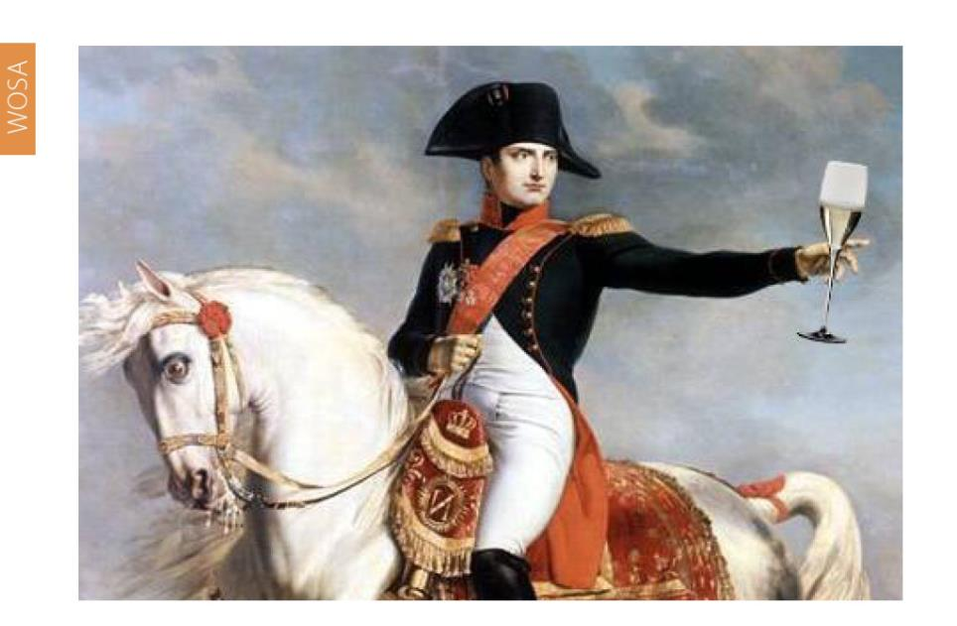
Mid-1700s – Our wine was famous in the courts of Europe
Notes:
In the 18th century, wines from Constantia were exported to Europe, and earned great acclaim for their sweet and luscious nature. Both Baudelaire and Jane Austen mentioned Constantia wines in their writing.

Slide 21
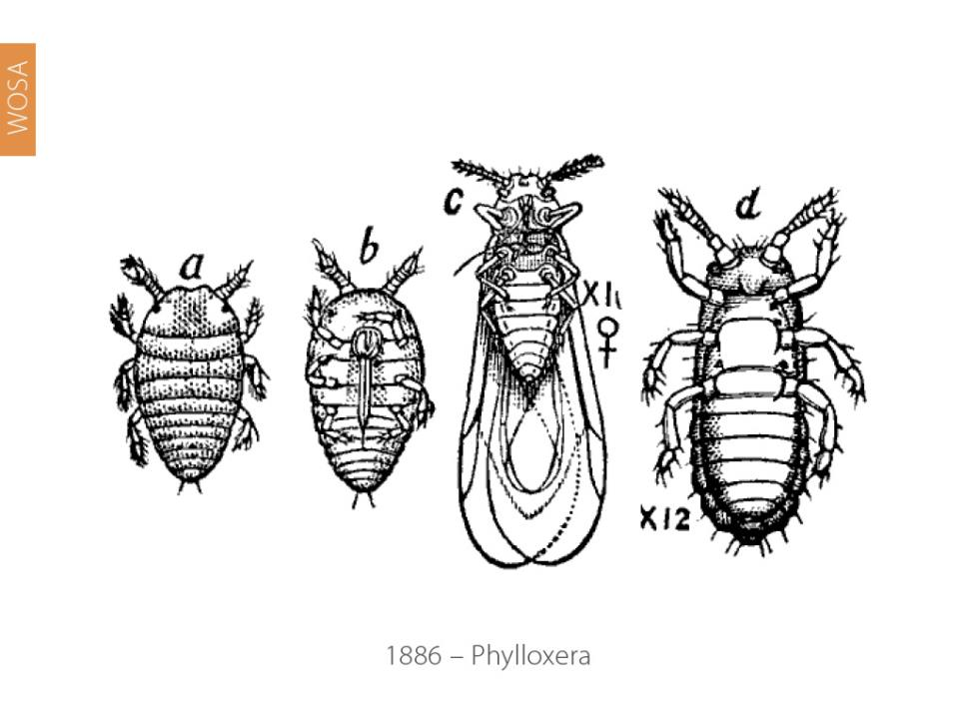
Notes:
1886 – Phylloxera was discovered on vines on the banks of the Liesbeek River in Mowbray for the first time. The disease spread rapidly and resulted in the uprooting and destruction of millions of vines throughout the Cape.

Slide 22
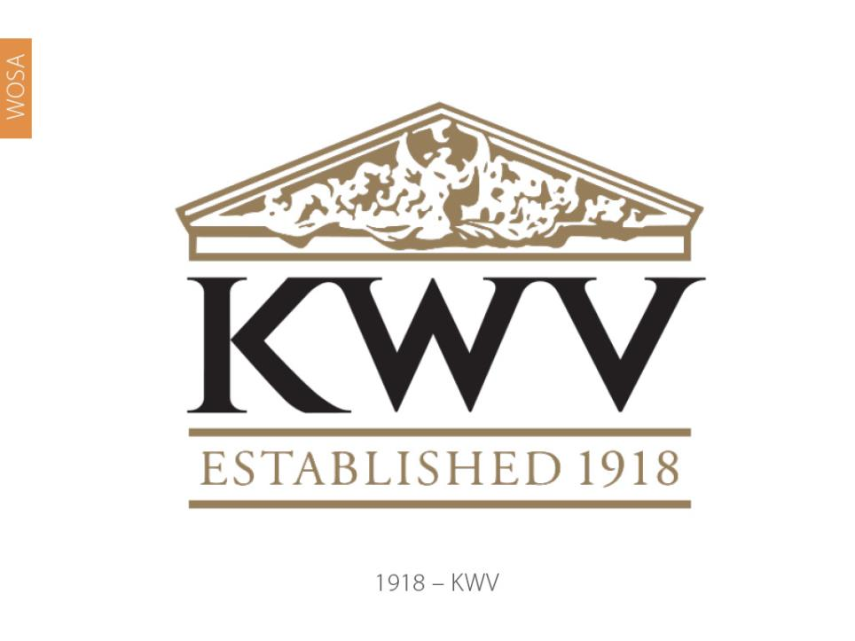
Notes:
1918 – The Ko-operatiewe Wijnbouwers Vereeniging van Zuid-Afrika Beperkt (KWV) was formed under the leadership of Charles WH Kohler, saving the industry from disaster through the control of volumes and production.

Slide 23
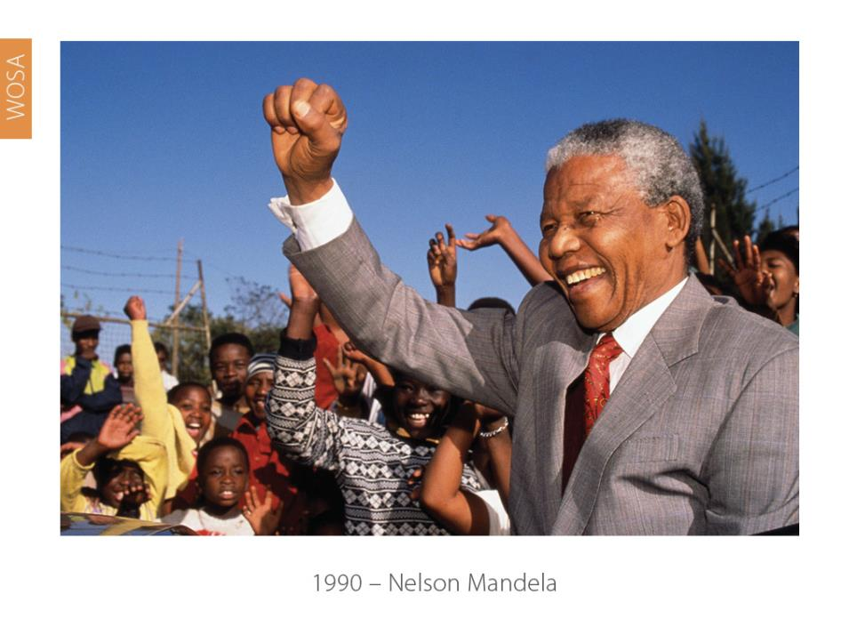
Notes:
1990 – Nelson Mandela was released, paving the way for increased acceptability of South African wine abroad.

Slide 24
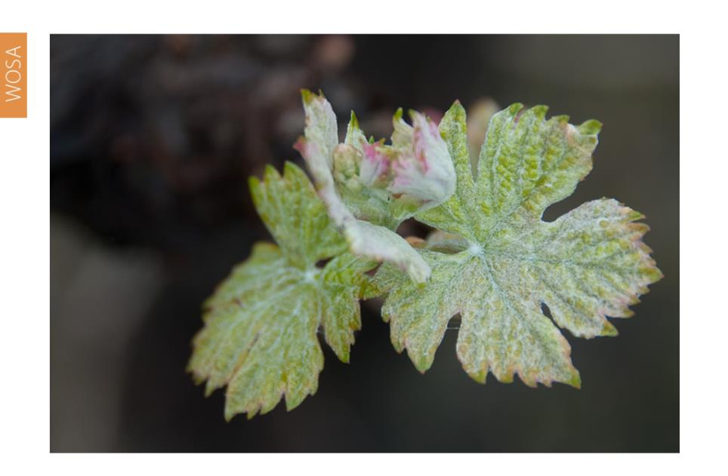
1994 – The birth of a modern wine industry
Notes:
1994 – South Africa became a democracy and the wine industry was also liberated. Wine exports started to take off, wine marketers and wine markets were exposed to international trends and know-how, and the farmers began replanting.

Slide 25
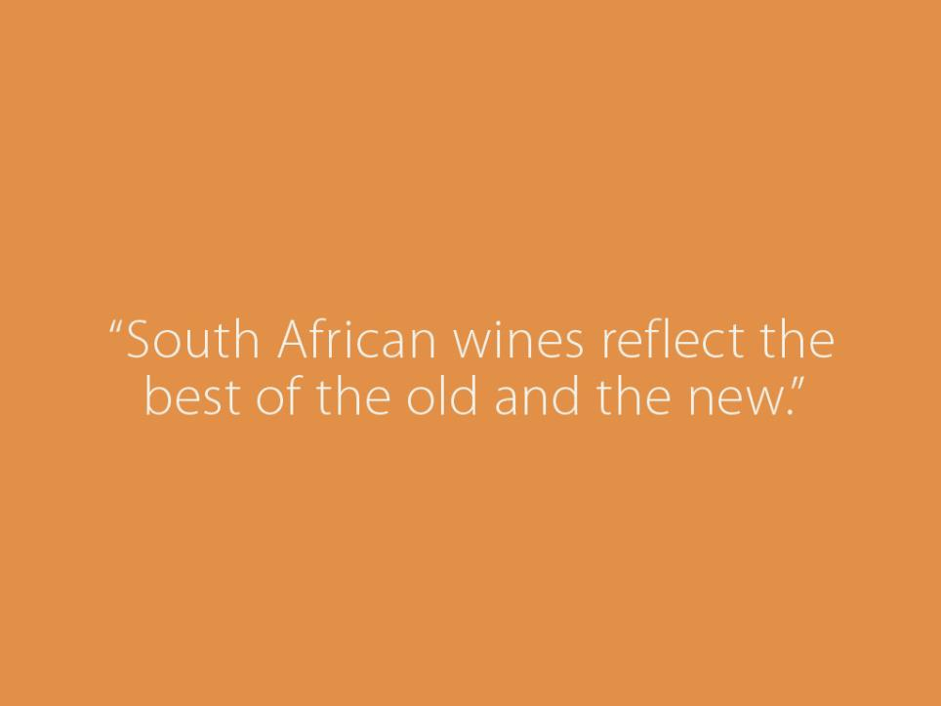
Notes:
South African wines reflect the best of both the old and the new – presenting fruit-forward styles with elegance, finesse and restraint.

Slide 26
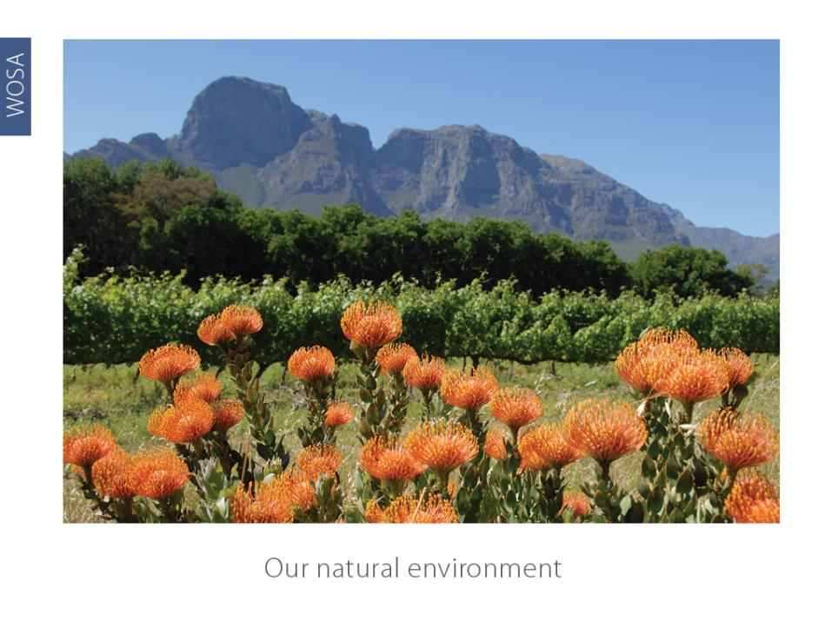
Our natural environment
Notes:
Our natural environment: Section 2

Slide 27
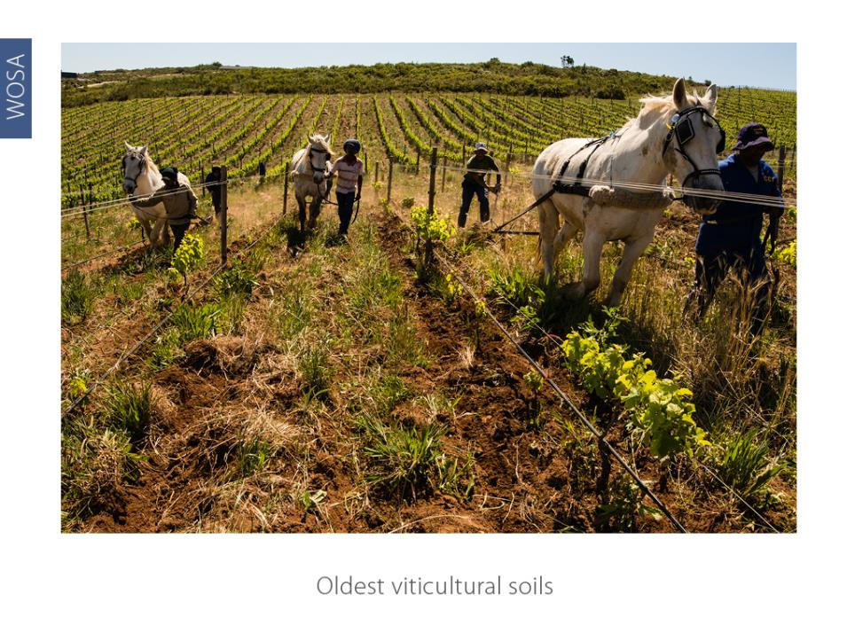
Oldest viticultural soils
Notes:
South Africa has the oldest viticultural soils in the world, dating back over 500 million years.

Slide 28
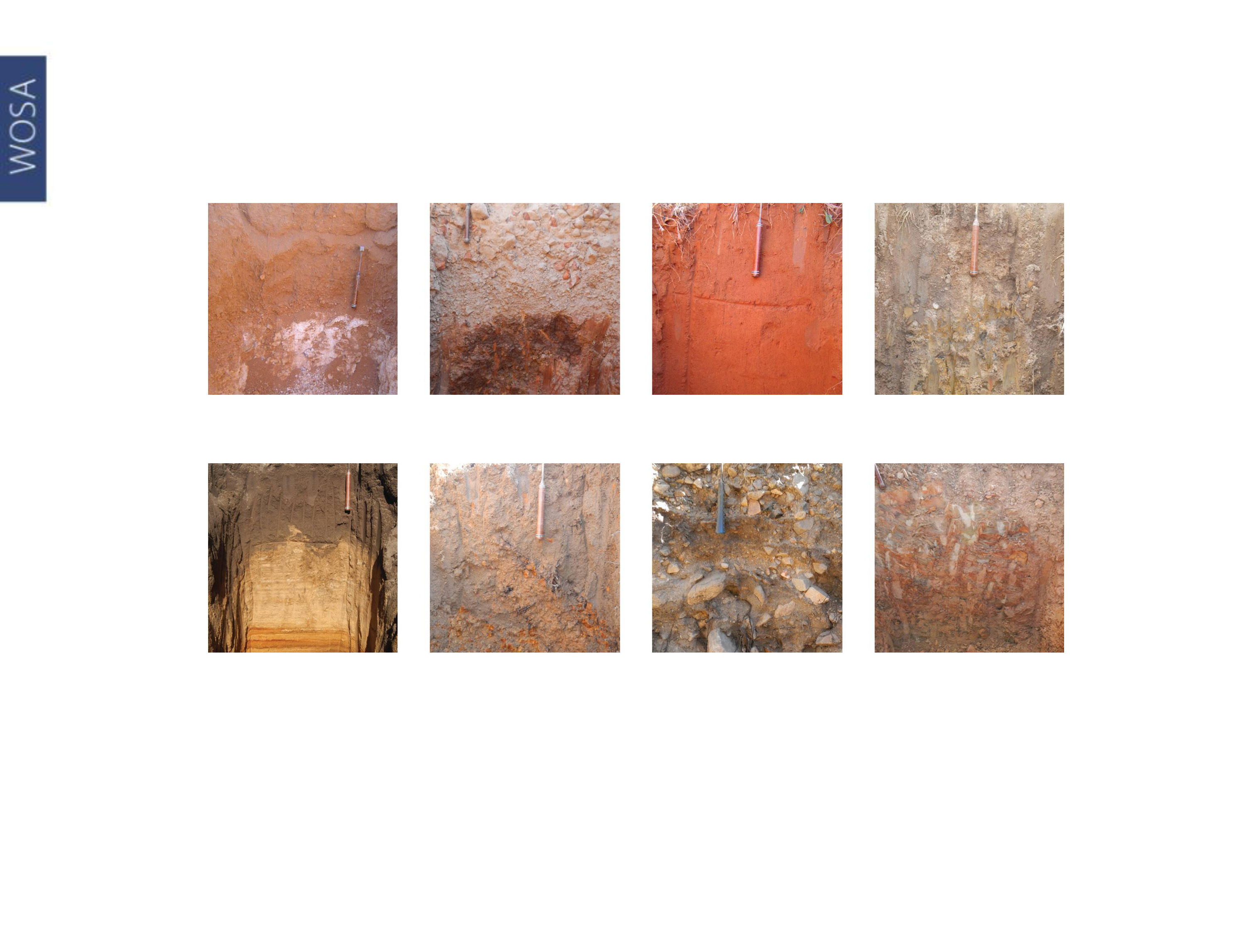
Calcic
Duplex
Oxidic
Gleycic
Podzolic
Plinthic
Cumulic
Lithic
Grouping of soil forms
Notes:
Soils vary greatly even within one hectare. The three most important soil groups are derived from shale, granite and sandstone.

Slide 29
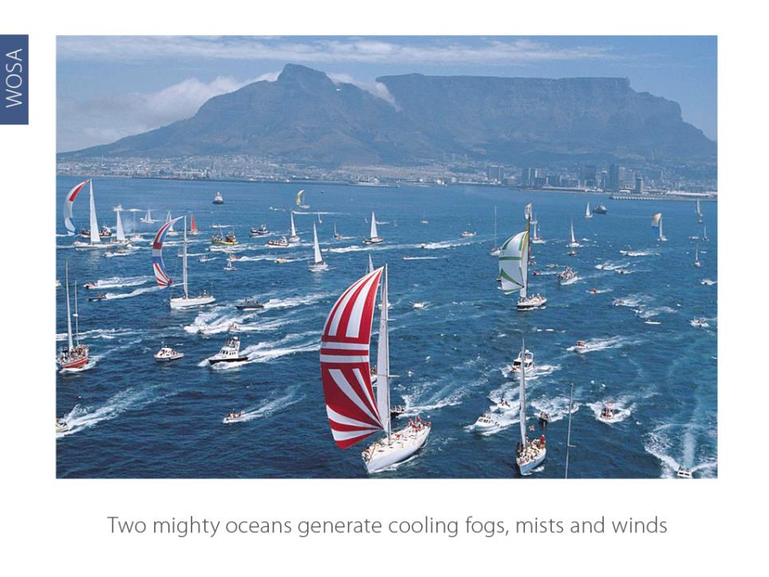
Two mighty oceans generate cooling fogs, mists and winds
Notes:
The Cape winelands are surrounded by two mighty oceans that generate fogs, mists and winds, which cool the vineyards.

Slide 30
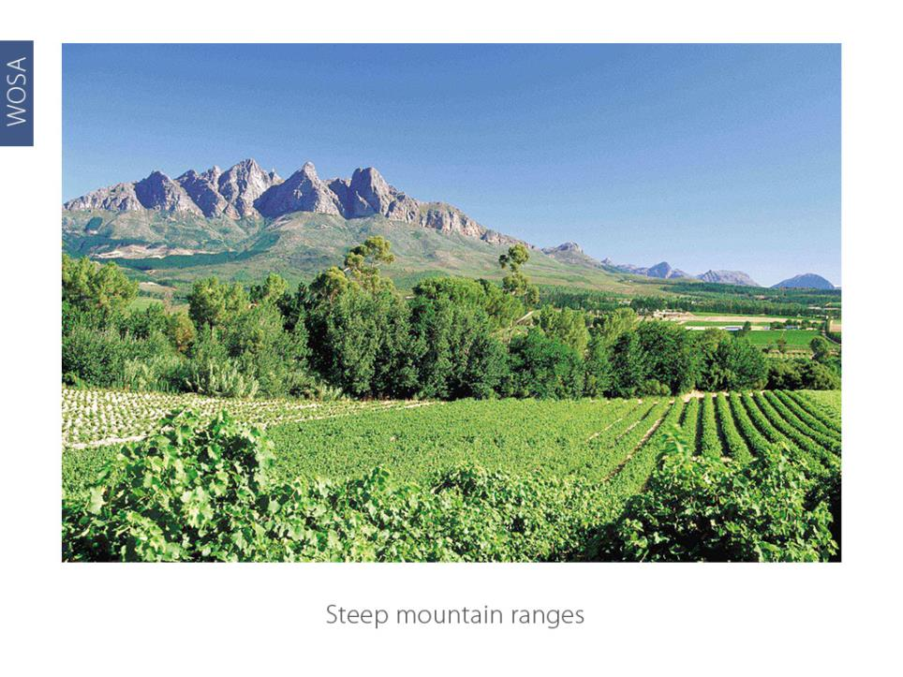
Steep mountain ranges
Notes:
The Cape winelands are crisscrossed by steep mountain ranges, giving each valley and wine region a different individual character.

Slide 31
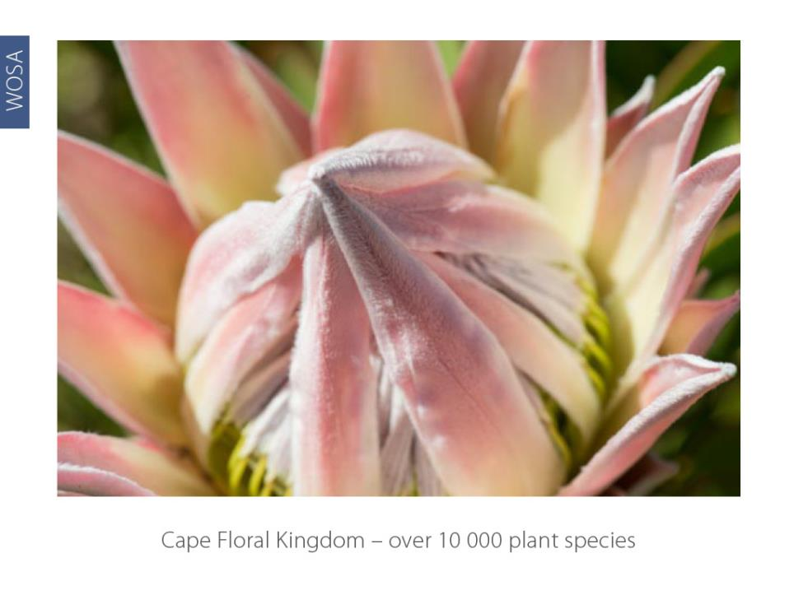
More than 9 500 endemic plant species of which 1 700 are threatened with extinction
Notes:
Over 95% of our wine is produced in the area known as the Cape Floral Kingdom. One of six such plant kingdoms in the world, it is the smallest, yet richest – home to over 10 000 plant species, more than are found in the entire Northern Hemisphere. It is recognised as a World Heritage Site. The Cape Floral Kingdom is one of 25 recognised biodiversity hotspots, with 70% of the plants found here not found anywhere else on earth.

Slide 32
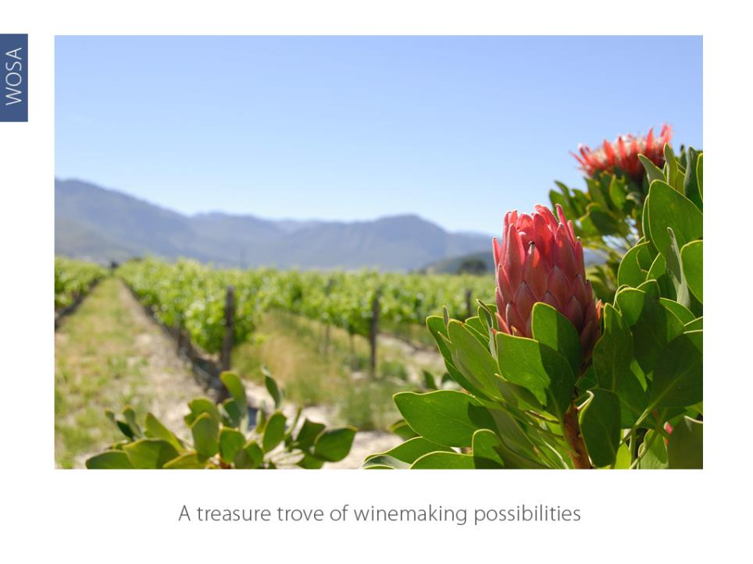
A treasure trove of winemaking possibilities
Notes:
The same array of unique soils and climates that created such a mind-boggling diversity of flora obviously also influences our vineyards and therefore our wines. Diversity of soils, matched by diversity of climate and geography, create a treasure trove of winemaking possibilities.

Slide 33
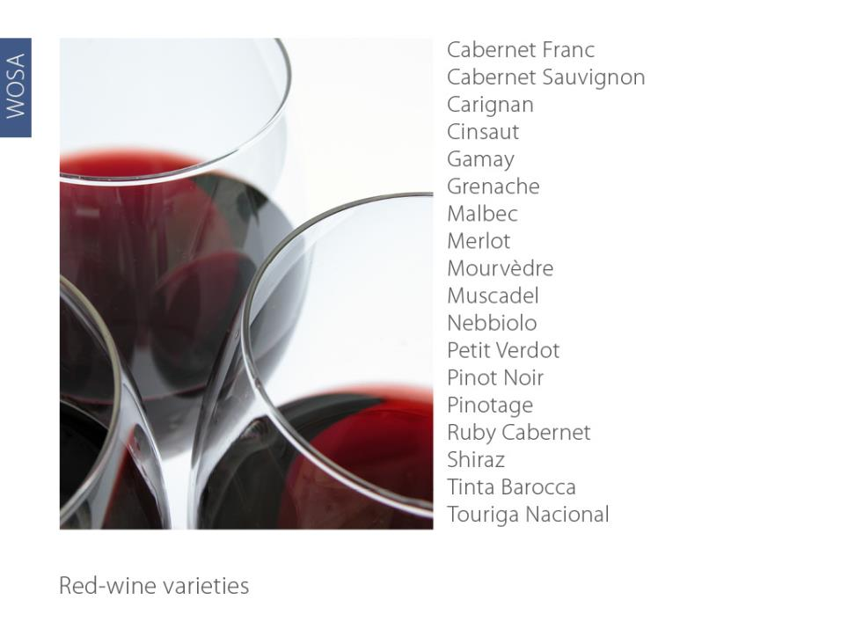
Notes:
A huge variety of red-wine varieties are planted. The most widely planted are Cabernet Sauvignon and Shiraz (Syrah).

Slide 34
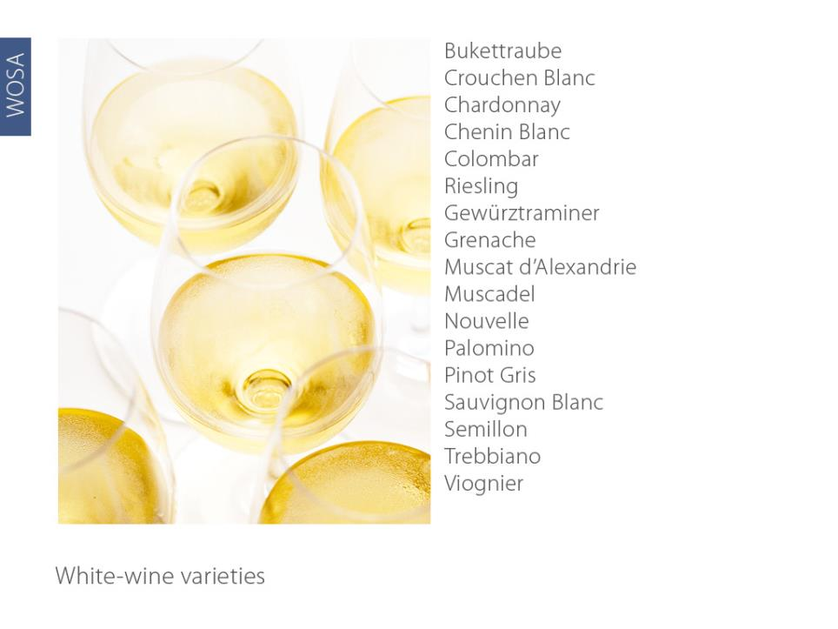
Notes:
A large variety of white-wine varieties are also planted. The most important are Chenin Blanc, Sauvignon Blanc and Chardonnay.

Slide 35
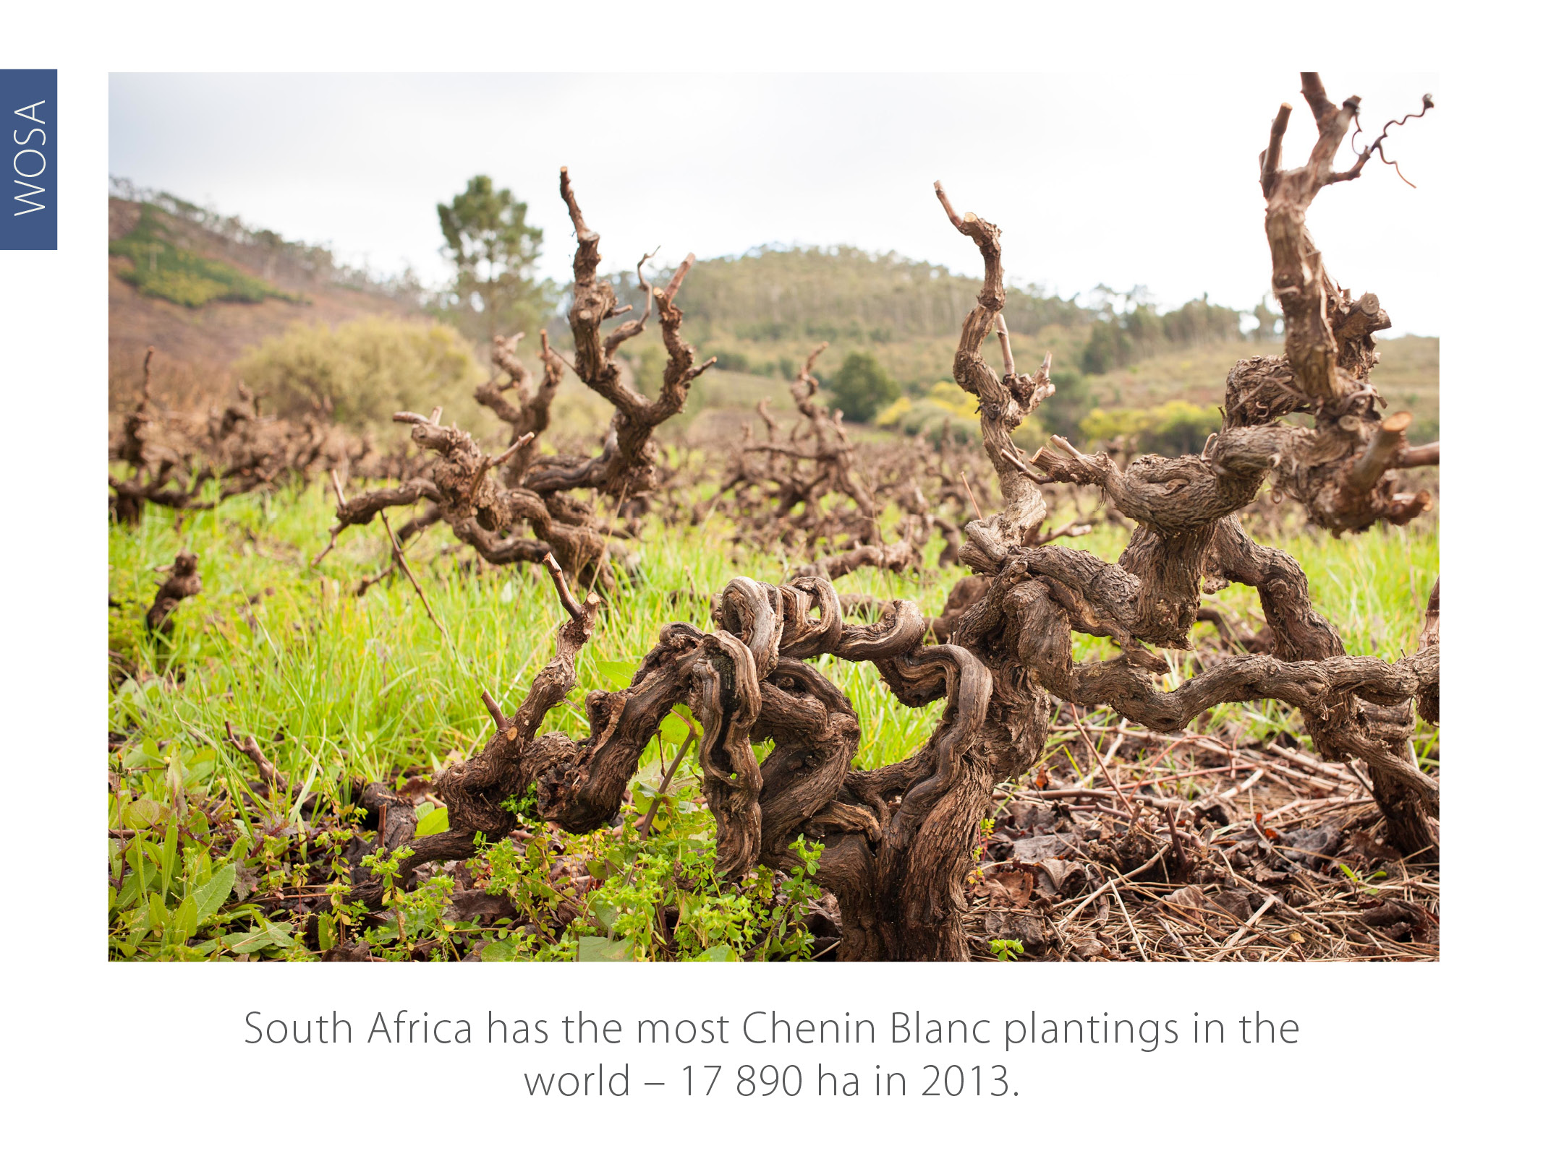
South Africa has the most Chenin Blanc plantings in the world
17 543 ha in 2017
Notes:
South Africa has the most Chenin Blanc plantings in the world – 17 934 ha in 2014.

Slide 36
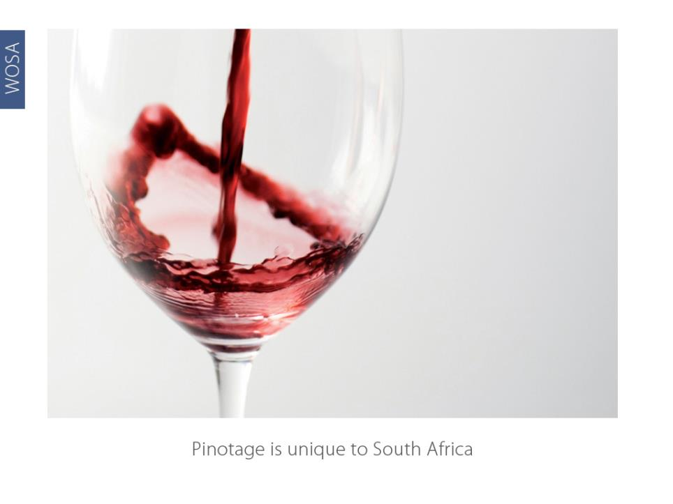
Pinotage is unique to South Africa
Notes:
The Pinotage grape variety is unique to South Africa. It was developed in 1925 by Prof Perold at the University of Stellenbosch, and is a cross between Pinot Noir and Hermitage (Cinsaut). Pinotage wine was first released commercially in 1961.

Slide 37
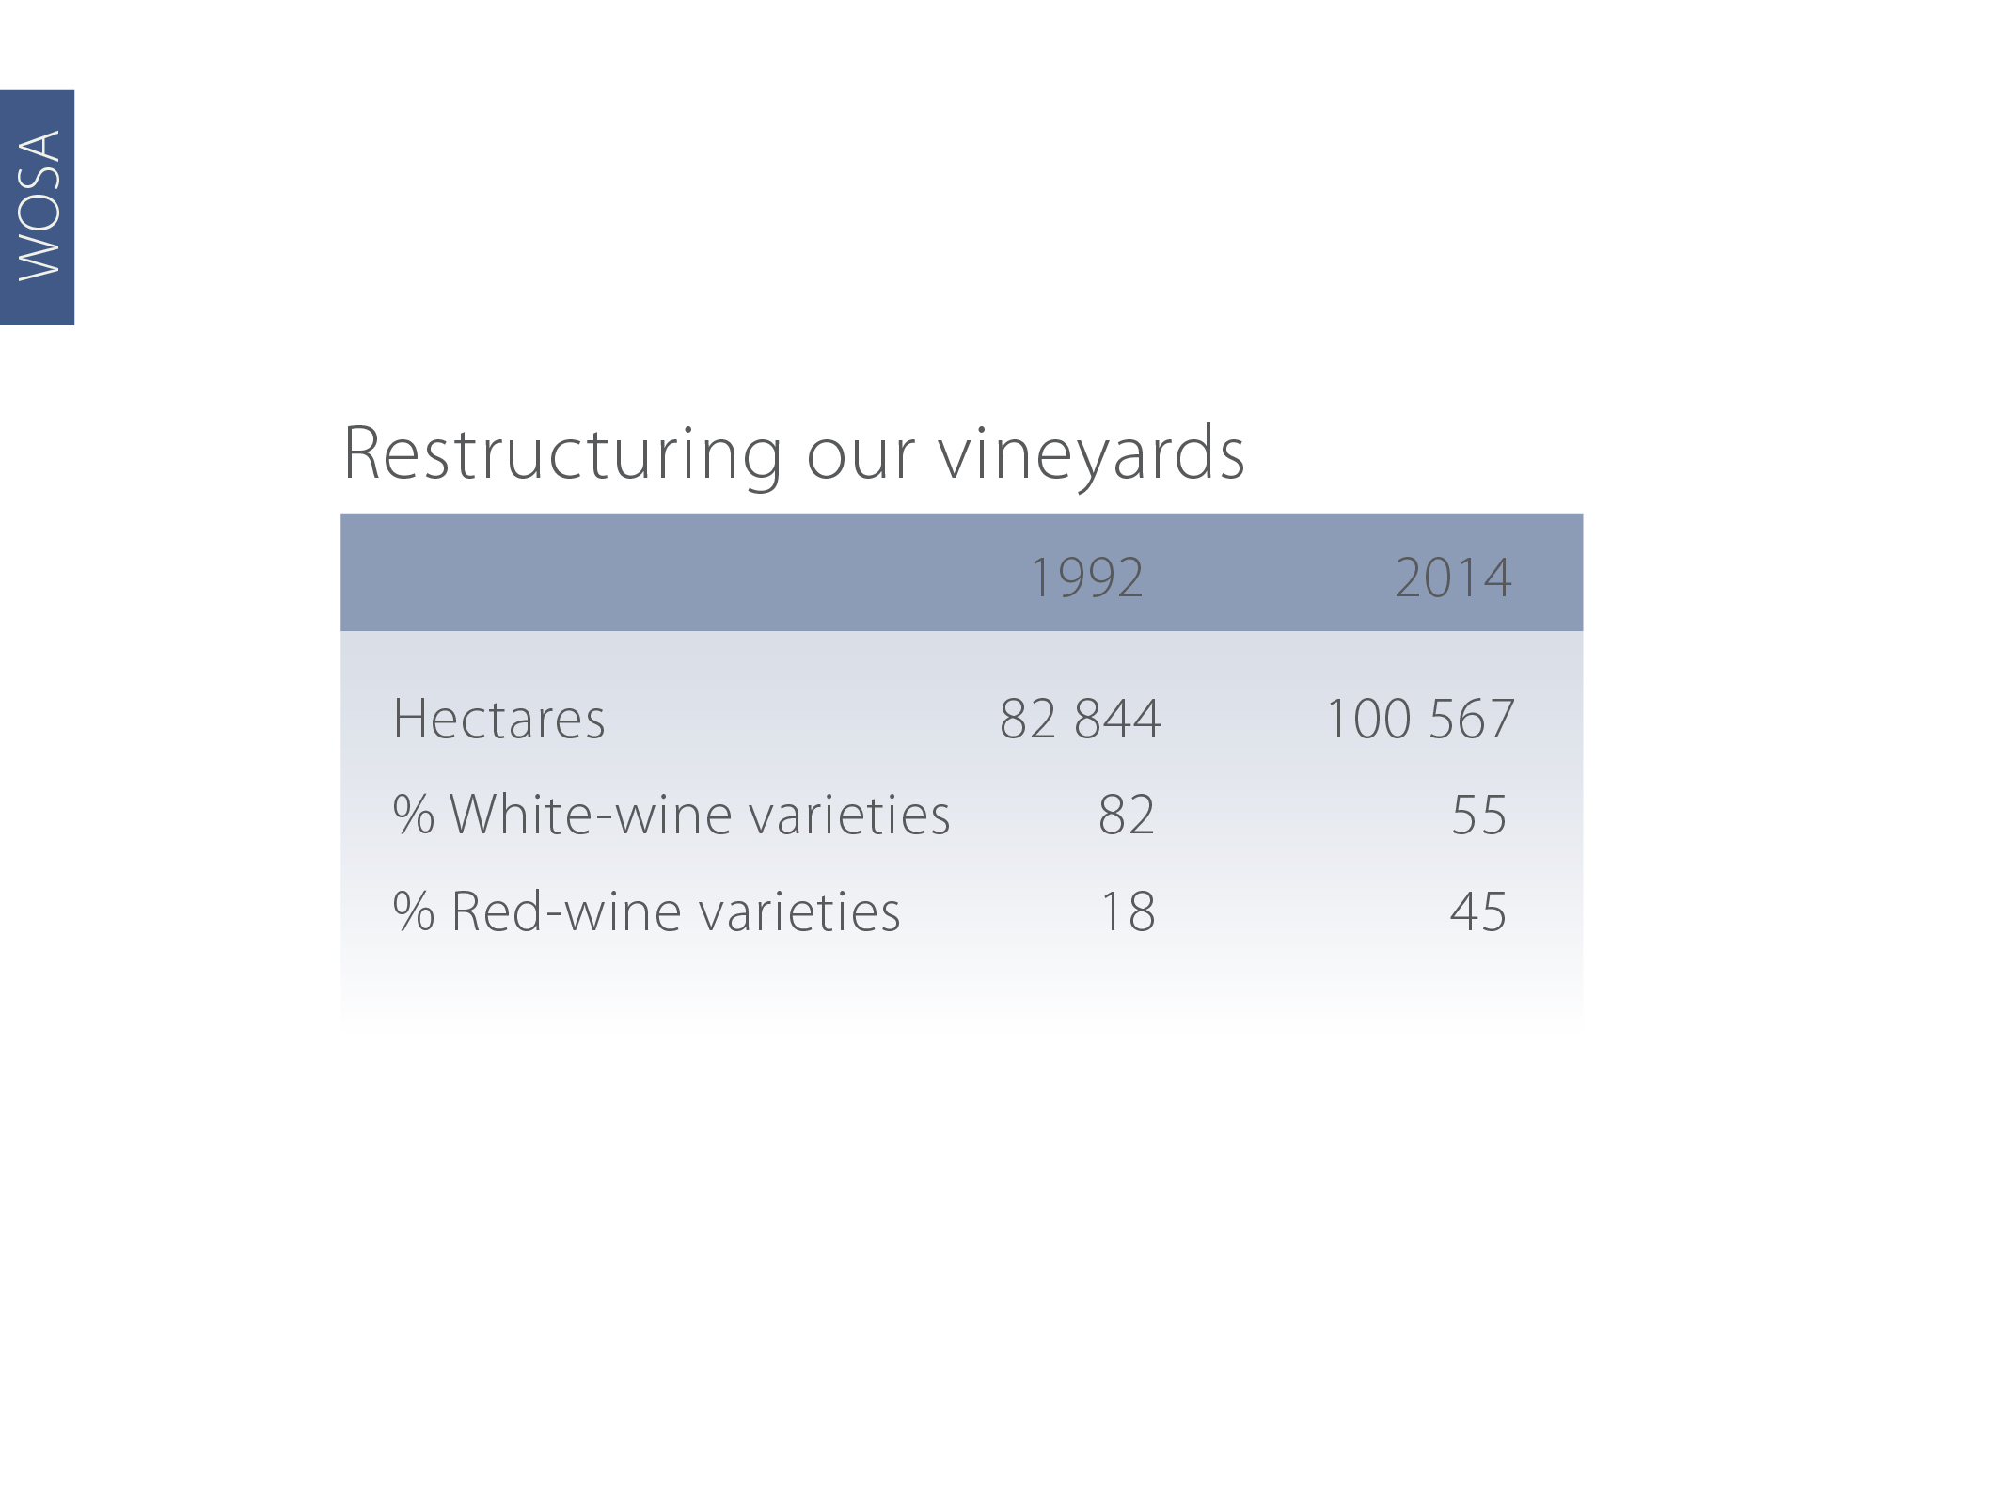
Restructuring our vineyards
 | 2012 | 2017
Hectares | 100 097 | 94 545
% white varieties | 55.1 | 55.2
% red varieties | 44.9 | 44.8
Notes:
The structure of South Africa’s vineyards has changed over the past two decades to be more in line with the international market demand.

Slide 38
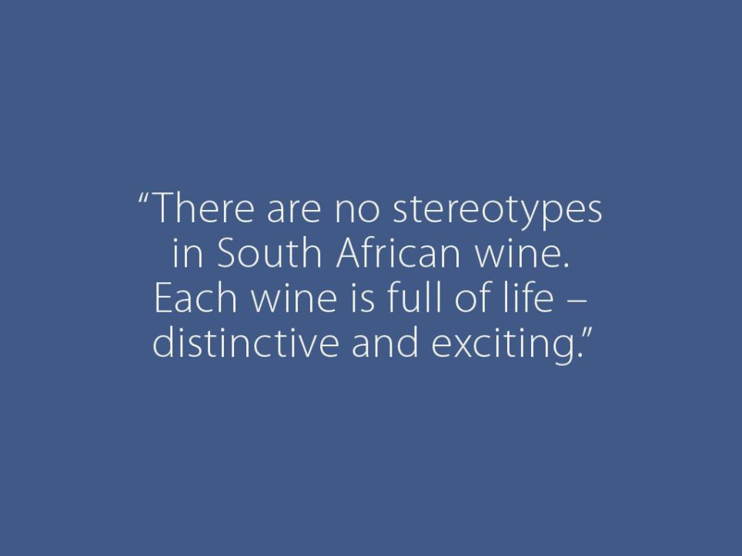
Notes:
There are no stereotypes in South African wine. Each wine is full of life – distinctive and exciting.

Slide 39
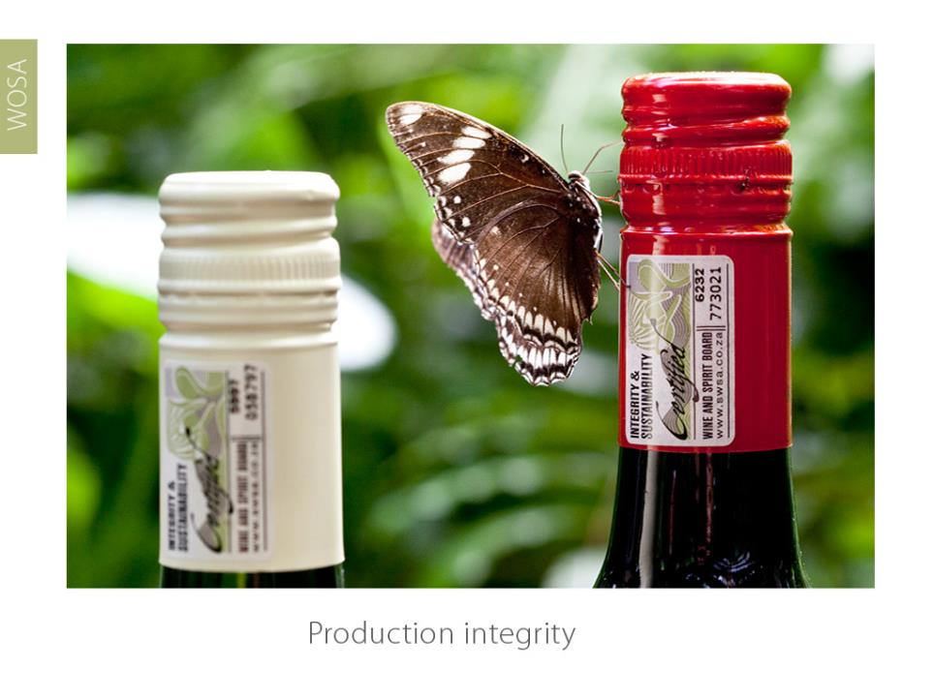
Notes:
Production integrity: Section 3

Slide 40
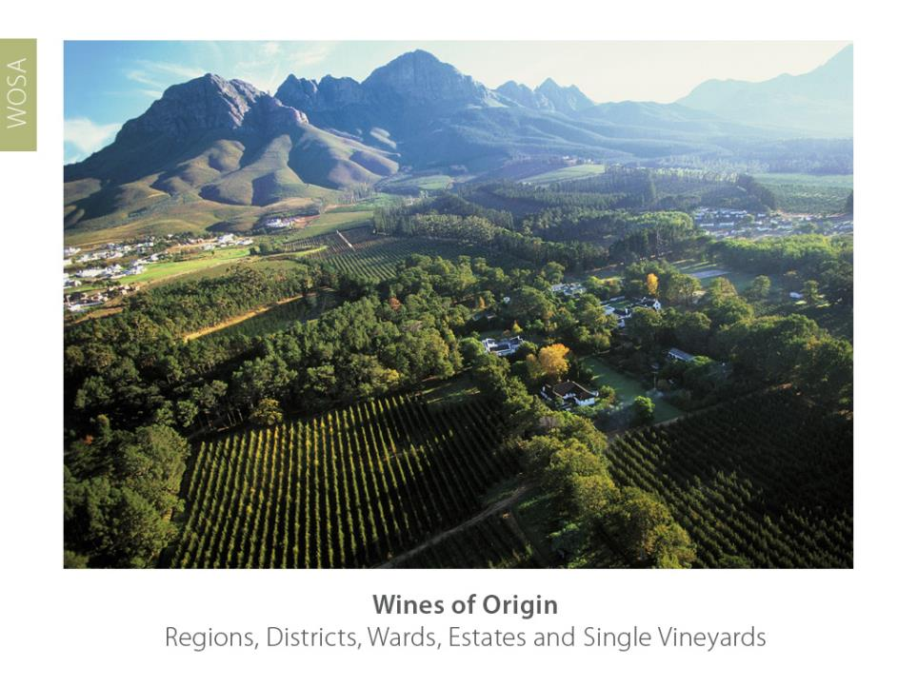
Notes:
The South African Wine and Spirit Board, appointed by the Minister of Agriculture, administers wine production under the extremely rigorous Wine of Origin certification scheme. The Wine and Spirit Board demarcates areas of origin, and the borders are defined by law. For a wine to claim an origin, 100% of the grapes must come from that area. The demarcated areas drill down from regions, to districts, wards and even specific vineyards.

Slide 41
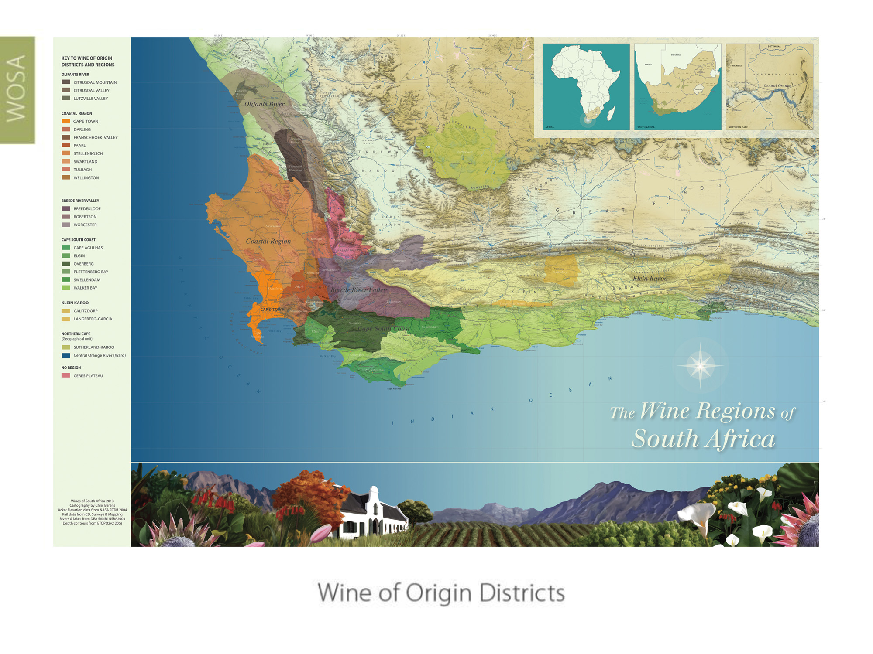
Notes:
With the exception of the vineyards along the Orange River and a few hectares in KwaZulu-Natal, all the South African vineyards are in the Western Cape, relatively close to Cape Town.

Slide 42
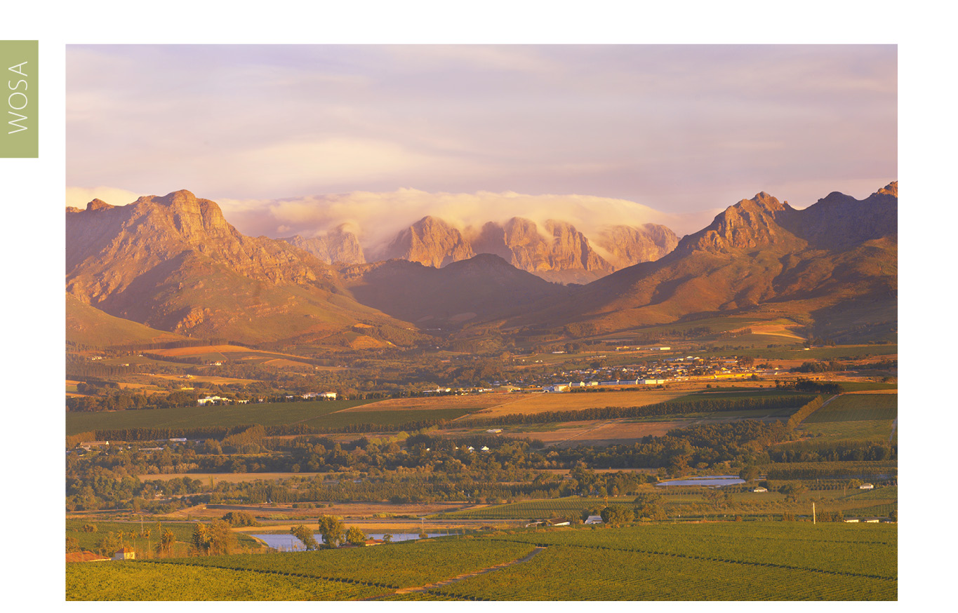
Established
Franschhoek Valley, Paarl, Stellenbosch, Constantia and Durbanville
Notes:
The most established winegrowing areas are the districts of Franschhoek Valley, Paarl and Stellenbosch, and the wards of Constantia, our oldest winegrowing area, and Durbanville.

Slide 43
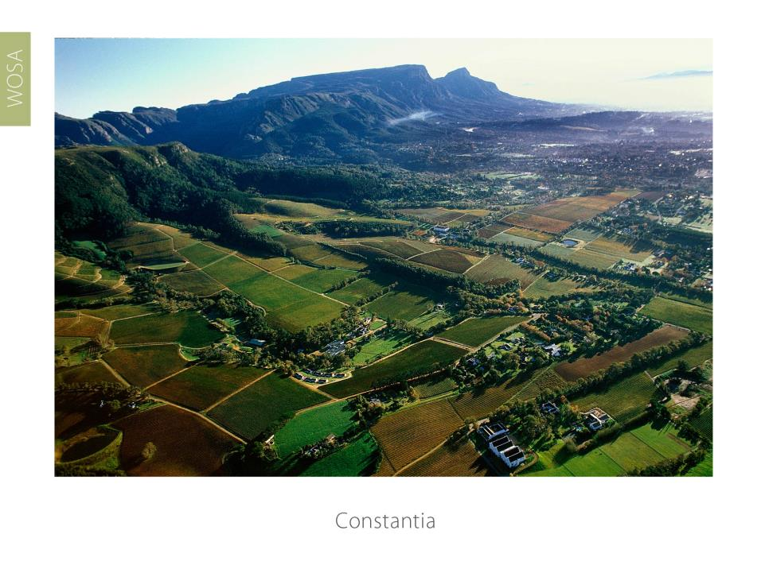

Notes:
Constantia lies on the slopes of the Constantiaberg, a southern extension of Table Mountain, and is only 20 minutes away from Cape Town.

Slide 44
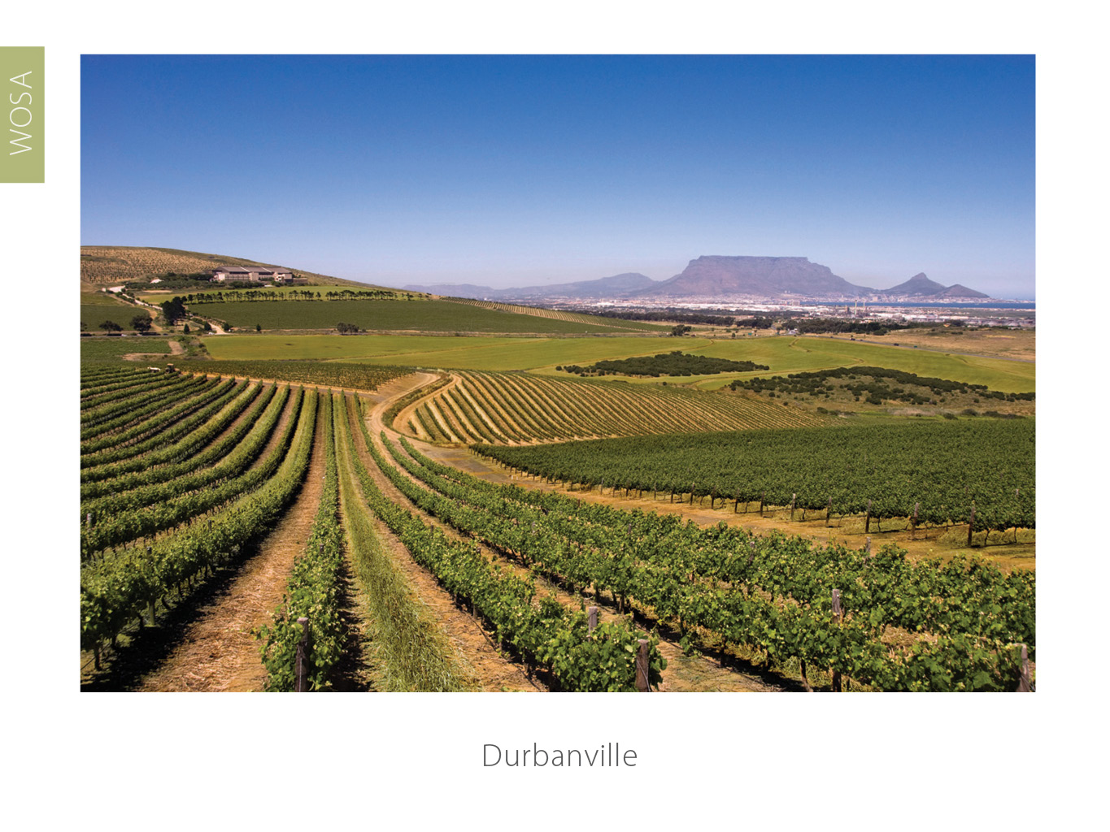
Notes:
Durbanville borders on Cape Town’s northern suburb and is characterised by a range of hills known as Tygerberg, from which the district this ward falls within takes its name.

Slide 45
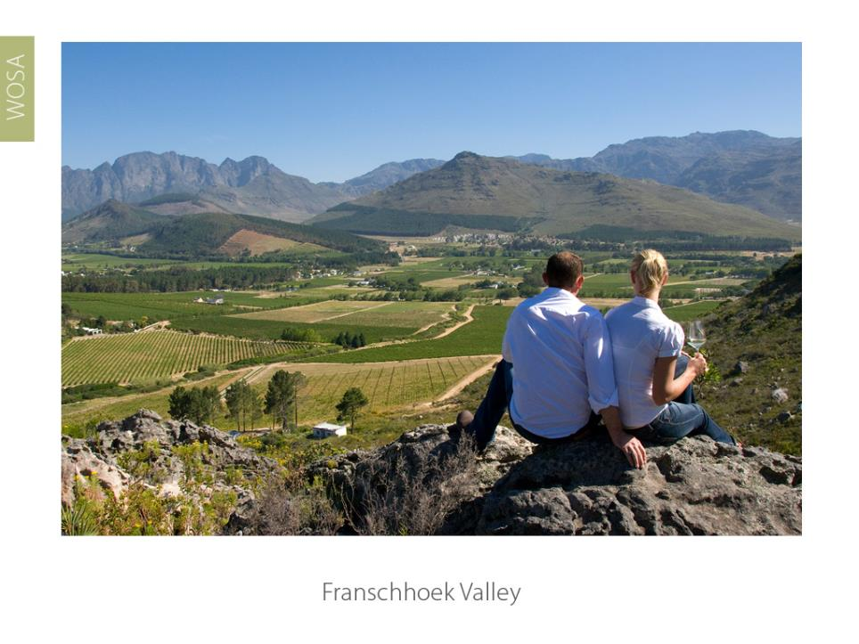
Notes:
The Franschhoek Valley district is enclosed on three sides by towering mountains and has retained its French charm as a romantic tourism destination.

Slide 46
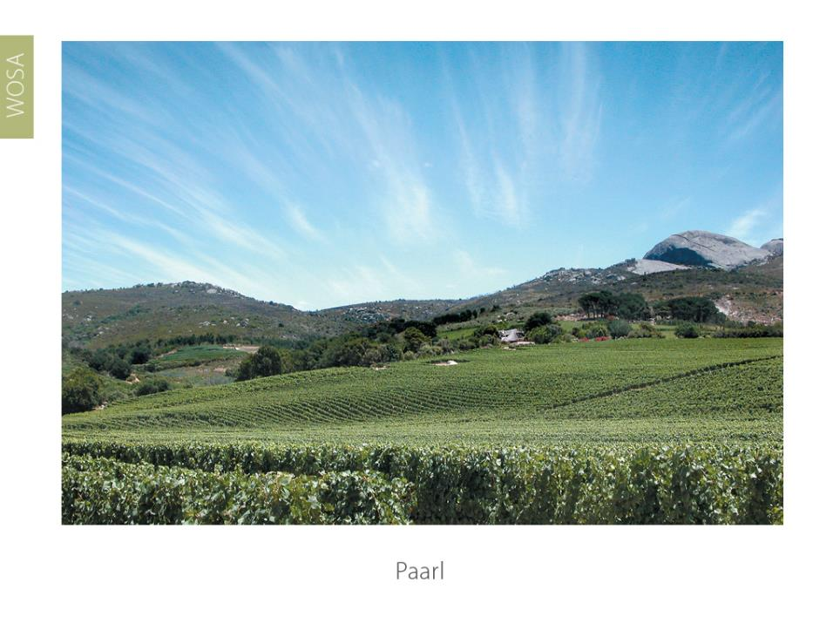
Notes:
Paarl is situated beneath a large granite outcrop, the second largest in the world, the biggest being Uluru (previously Ayers Rock) in Australia.

Slide 47
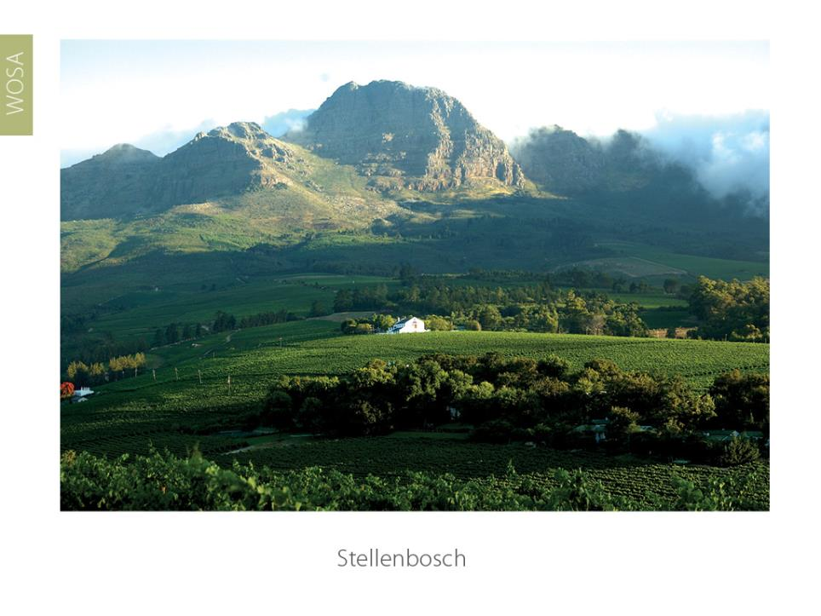
Notes:
Stellenbosch is a university town and the centre of the wine trade.

Slide 48
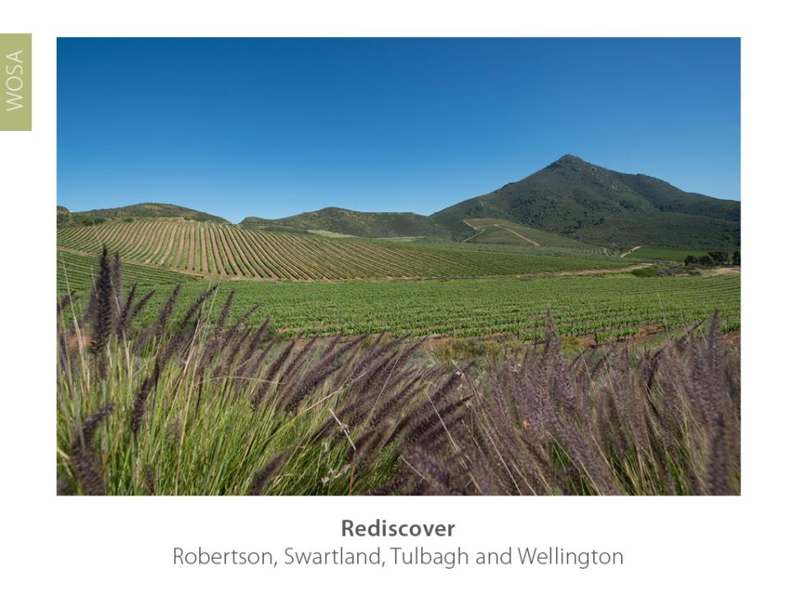
Notes:
Older areas that are being rediscovered are Robertson, Swartland, Tulbagh and Wellington.

Slide 49
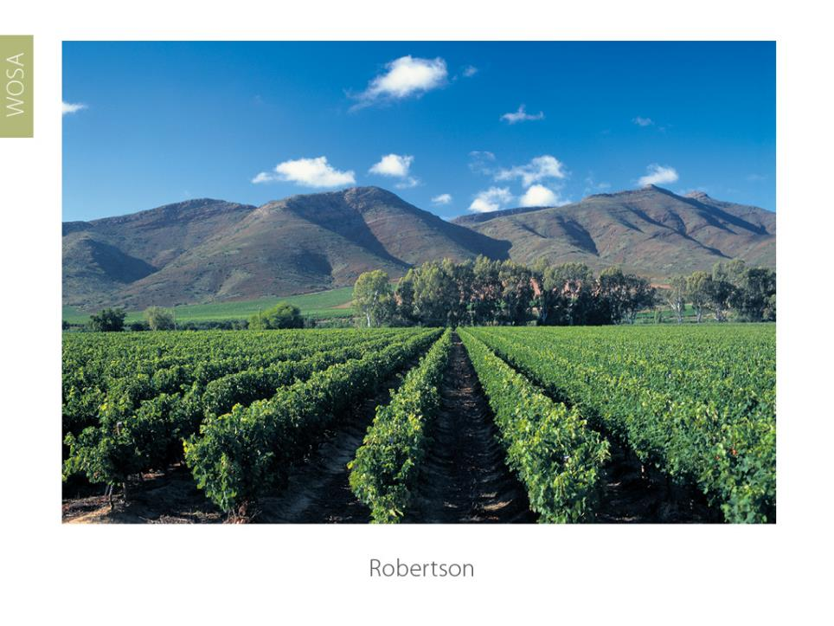
Notes:
The Robertson district runs along the Breede River and is characterised by extreme differences in day and night temperatures.

Slide 50

Notes:
Traditionally a grain-producing area, the Swartland district is interspersed with older bush vines. A group of winemakers are driving an exciting renaissance here.

Slide 51

Notes:
The Tulbagh district is a secluded valley characterised by a unique ‘cold trap’ – a cloud layer that keeps cool night air in the valley until quite late into the morning.

Slide 52

Notes:
Wellington, which has recently been demarcated a district, is where most of the vineyard nurseries are located.

Slide 53

Notes:
Explore winegrowing areas along the West Coast, which are influenced by the cold Benguela current.

Slide 54

Notes:
The Darling district comprises a range of hills running parallel to the Atlantic Ocean.

Slide 55

Notes:
In the Olifants River region newer wards such as Bamboes Bay, as well as stand-alone wards like Cederberg and Lamberts Bay, are producing exciting wines.

Slide 56

Notes:
New and exciting areas that have emerged in the Cape South Coast region in the past decade are Bot River, Elgin, Elim and Hemel-en-Aarde.

Slide 57

Notes:
The Bot River ward is renowned for its cool maritime microclimate, which is influenced by its proximity to the lagoon and Walker Bay.

Slide 58

Notes:
The cool Elgin district was originally an apple-growing region and is increasingly maximising on these climatic features to produce cool-climate wines.

Slide 59

Notes:
The Elim ward is the southernmost of the maritime vineyards – it’s exposed to very strong south-easterly winds.

Slide 60

Hemel-en-Aarde Valley
Notes:
Hemel-en-Aarde comprises three distinct wards. Hemel-en-Aarde Valley, Hemel-en-Aarde Ridge and Upper Hemel-en-Aarde Valley.

Slide 61

Klein Karoo – fortified & Portuguese varietal table wines
Notes:
The elongated semi-arid Klein Karoo region is well known for its port-style wines.

Slide 62

Breedekloof – a traditionally high-yielding region with a recent trend
towards smaller batches
Notes:
High-yielding areas include Breedekloof, Central Orange River and Worcester.

Slide 63

Notes:
The vineyards of the Breedekloof area flourish on the alluvial valley soils.

Slide 64

Notes:
Central Orange River alongside the Orange River is the most northerly winegrowing area in South Africa.

Slide 65

Notes:
Worcester’s winelands are traditionally planted in the fertile flood plains of the Breede River.

Slide 66

Notes:
The /Xam San were the world’s first environmentalists. Their legacy lives on in the commitment of South Africa wine producers to farm sustainably and conserve their land for future generations. This philosophy is embodied in the San word ≠hannuwa, which means ‘the gathering of good fortune through living in harmony with nature’.

Slide 67

Notes:
Sustainable Wine South Africa is administered by the Wine and Spirit Board, and drives the sustainable farming initiative, the Integrated Production of Wine (IPW). It employs independent auditors to check the IPW status of winegrowers. IPW is a scheme that specifies environmentally sustainable practices, rules and regulations. This scheme was introduced to the industry in 1998. Guidelines cover environmental impact care, monitor water usage, health and safety, and protect and conserve our unique natural habitat.

Slide 68

Notes:
From 2010, producers who are certified as sustainable by Sustainable Wine South Africa have been be able to use the new Wine and Spirit Board certification seal that highlights this commitment to environmentally sustainable wine production. Consumers can trace every bottle back to the vineyard practices of its source, and know that the wine has been sustainably produced and audited as such.

Slide 69

Notes:
For a producer to make a claim on a wine label, 85% of the wine must come from that vintage, 85% of the wine must come from that variety and 100% of the wine must come from that area.

Slide 70

Notes:
The certification seal on the bottle is an absolute guarantee to the consumer that the claims on the packaging regarding vintage, variety and origin are true, and the wine was of good quality when evaluated by the Wine and Spirit Board for certification.

Slide 71

Notes:
The South African wine industry is concerned with the triple bottom line: profit, people and the environment.

Slide 72

Notes:
South Africa is unique in that our wine industry has established the Wine Industry Ethical Trade Initiative (WIETA), an independent, not-for-profit, multi-shareholder organisation established in 2002. Committed to ethical trading, and improving and safeguarding the working conditions of employees in agriculture.

Slide 73

Notes:
In 2012, WIETA introduced a new ethical seal that testifies to reasonable working conditions, based on rigorous and closely monitored qualification criteria. This is believed to be a world first among wine-producing countries.

Slide 74

Pebbles – pre-primary farm project
Notes:
Producers are keen to help a new generation of farm children access educational opportunities that were denied their parents. This is a toy library run by the Pebbles Project, one of the many NGOs operating on the farms.

Slide 75

Fairtrade wines – two thirds sold worldwide from South Africa
Notes:
South Africa has more Fairtrade wines than any other country. In 2014, 75% of all Fairtrade wines sold in the world originated in South Africa.

Slide 76

Notes:
Black-owned brands are gaining traction as the wine industry becomes more representative of the general population.

Slide 77

Notes:
South African wines lead the world in production integrity and environmental sustainability.

Slide 78

Wamkelekile – the warmest welcome
Notes:
‘Wamkelekile’ means ‘The warmest welcome’ in isiXhosa: Section 4

Slide 79

Notes:
Modern South Africans are descended from many origins and the country has 11 official languages.

Slide 80

Notes:
There are extraordinary people in South Africa’s past and present, for example iconic leader Nelson Mandela.

Slide 81

Notes:
Four South Africans have won the Nobel Peace Prize: Albert Luthuli (1960), Desmond Tutu (1984), Nelson Mandela (1993) and FW de Klerk (1993).

Slide 82

Notes:
Ubuntu is a unique South African philosophy which is about the essence of humanity. You can’t exist as a human in isolation, we are all interconnected.

Slide 83

Notes:
South Africa’s diverse cultural heritage is reflected in Cape cuisine, which marries all the influences of our origins with wonderful produce.

Slide 84

Notes:
South Africans are passionate about cooking meat on the barbeque, which they call a braai.

Slide 85

Notes:
Wild buck are still found in the mountains and countryside – many farmers keep small herds.

Slide 86

Notes:
The Cape Leopard Trust, which facilitates conservation of the Cape’s predator diversity through implementing conservation strategies, research projects and tourism initiatives, was launched in 2004 and has achieved remarkable success.

Slide 87

Notes:
At the Victoria and Albert Waterfront, tourists from all over the world enjoy our memorable cuisine and wines, all with a stunning view of majestic Table Mountain.

Slide 88

Notes:
There are many fine restaurants at wineries within easy driving distance of Cape Town.

Slide 89

Notes:
There are wonderful beaches all around the Cape.

Slide 90

Notes:
All very different and spectacular.

Slide 91

Notes:
South African wines are wines to enjoy because we understand that life is good.

Slide 92

Notes:
A quick look at the statistics and figures: Section 5

Slide 93

  South Africa ranks as eighth in the overall volume production
  of wine and produces 4.1% of the world’s wine (2017)
Notes:
In terms of world wine production, South Africa ranks as number 7 in overall volume production of wine and produces 4.0% of the world's wine (2014).

Slide 94


Area under wine grape vineyards (excluding Sultana)
SOURCE: SAWIS
Notes:
Total ha under wine grapes: From 100 207ha in 2004 to 99 463 ha in 2014.

Slide 95

Wine grape vineyards planted and uprooted
(excluding Sultana)
SOURCE: SAWIS
Notes:
Although total plantings have not increased significantly, there has been a dramatic restructuring of the South African vineyards with substantial uprooting and replanting in the past two decades.

Slide 96

Wine grapes as % of total vineyard area
Variety | 2017
Chenin Blanc | 18.6%
Colombar(d) | 11.9%
Sauvignon Blanc | 9.8%
Chardonnay | 7.1%
Total white-wine varieties | 55.2%
Cabernet Sauvignon | 11.0%
Shiraz | 10.3%
Pinotage | 7.4%
Merlot | 5.8%
Total red-wine varieties | 44.8%
SOURCE: SAWIS
Notes:
In 1990, 84% of the vineyards were planted to white-wine varieties. In 2014, the figure was 54.6%.

Slide 97

Age of Vineyards (excluding Sultana)
SOURCE: SAWIS
Notes:
31% of South Africa’s total vineyards are under 10 years old. In the case of red-wine varieties the figure is 10% and white-wine varieties 20%.

Slide 98

Exports in Litres
SOURCE: SAWIS
Notes:
Since the advent of democracy South Africa has achieved notable success in exports, with volumes increasing from 22 million litres in 1992 to 422.7 million litres in 2014.

Slide 99

Africa
Canada
China
Germany
Hong Kong
Japan
Sweden
The Netherlands
UK
USA
Countries
www.wosa.co.za
Notes:
The UK is South Africa’s number one export destination, followed by European countries such as Sweden, Germany and The Netherlands. The USA, Canada, Africa and China are increasingly important destinations.

Slide 100

Notes:
South African wines are constantly improving, a fact reflected in the increasing number of international accolades.

Slide 101

Notes:
Why are South African wines so special?

Slide 102

Notes:
You can taste the life in South African wines because, where our vines grow, there is more diverse life per square metre than anywhere else on the planet.

Slide 103

Notes:
There is a purity and intensity in our wine flavours that comes from growing our wines in harmony with our environment and its over 10 000 other plant species.

Slide 104

Notes:
All human beings can trace their ultimate heritage to South Africa – maybe that’s why South African wines taste of ‘home’.

Slide 105

Notes:
Thank you

Slide 106

Notes:
The end

